Slide 1
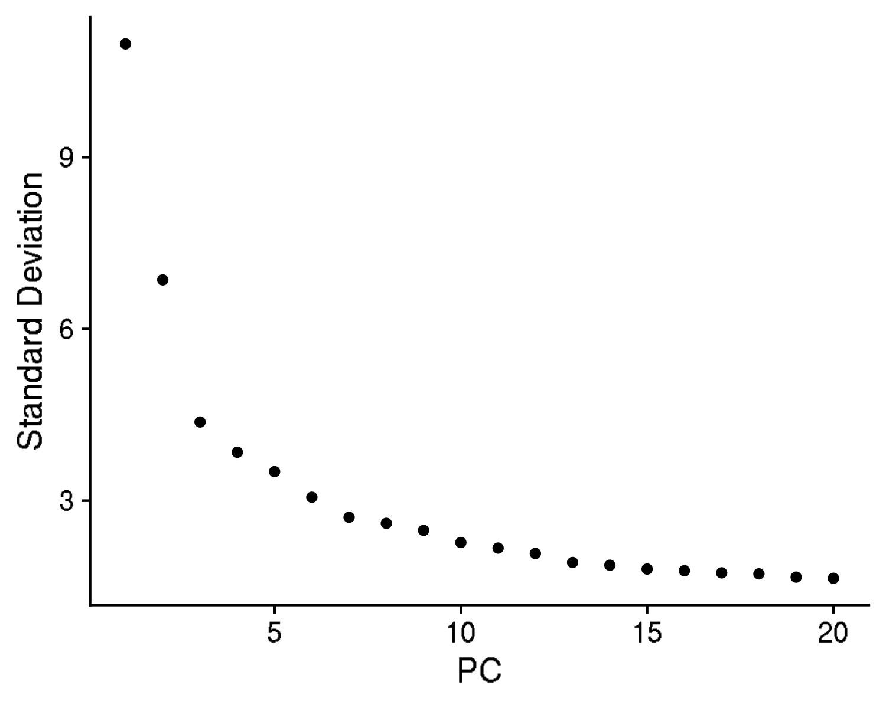
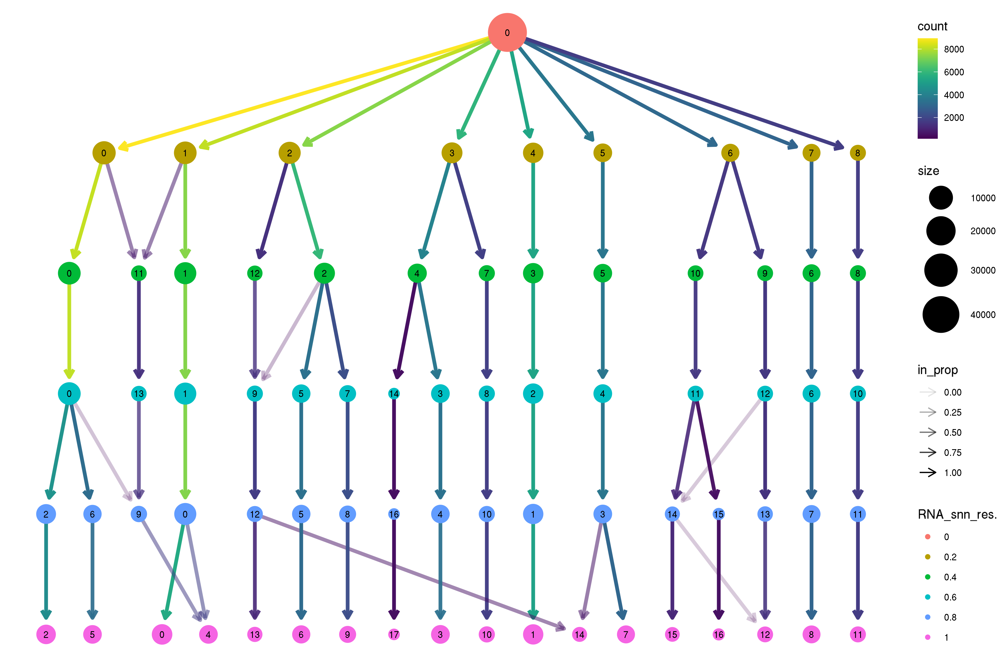
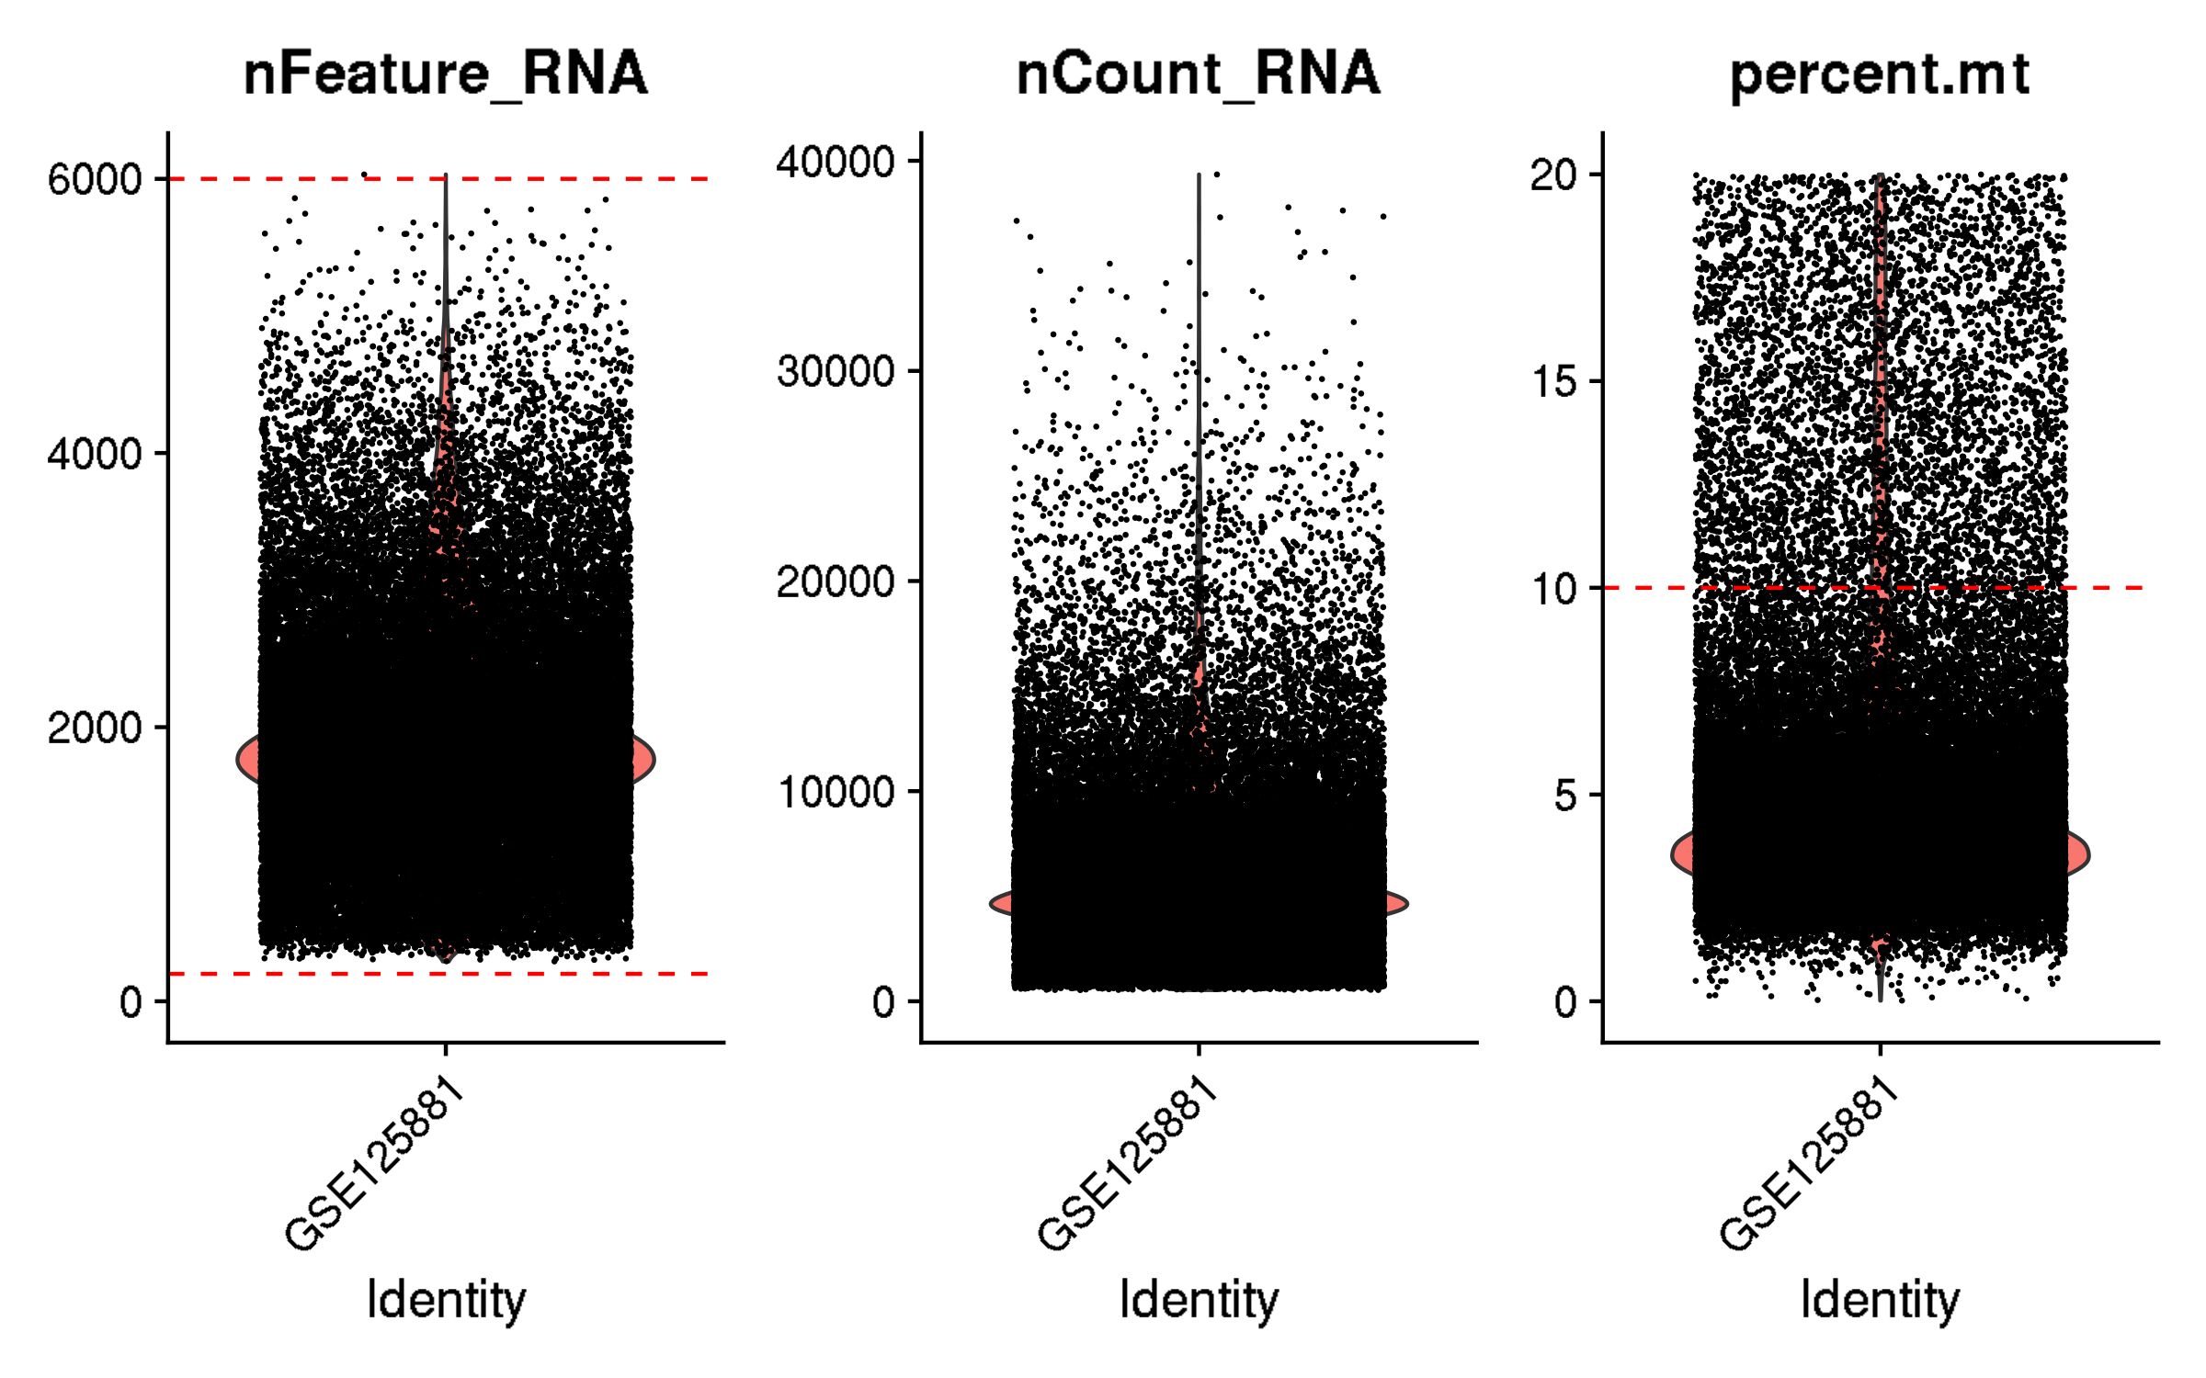
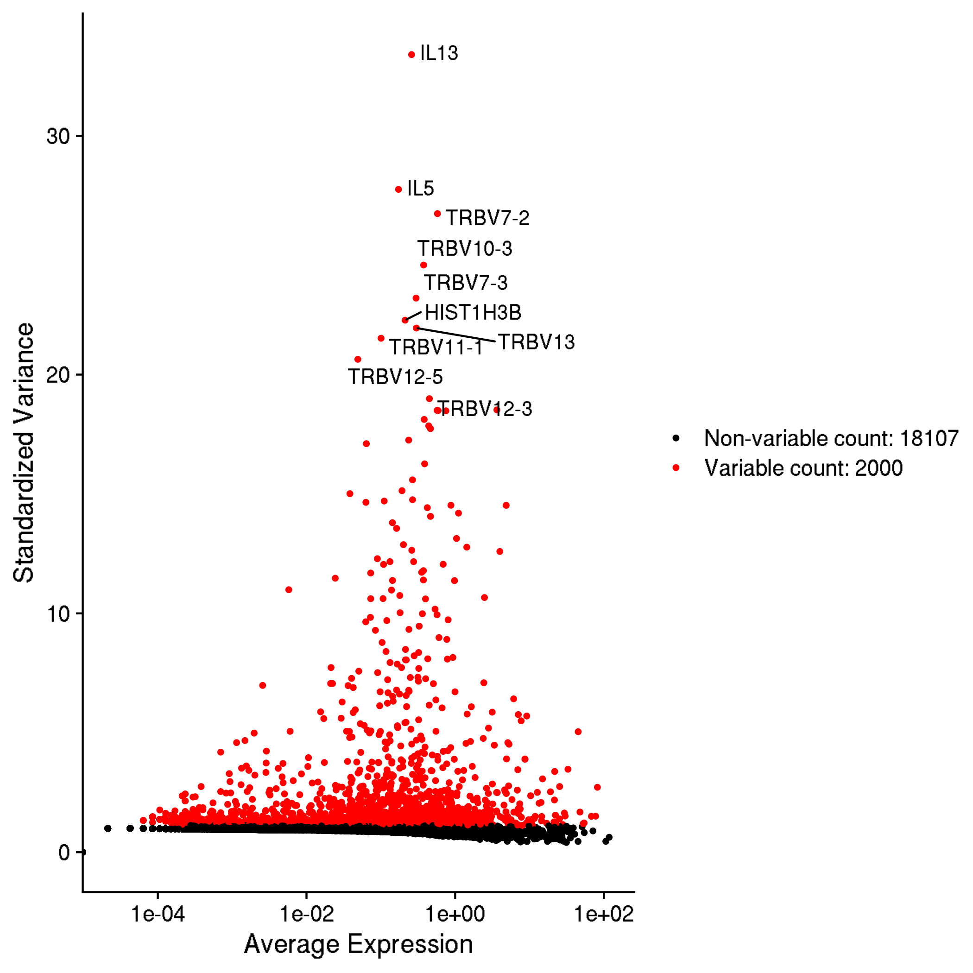
GSE125881: longitudinal kinetics of CD19 CAR T cells in cancer patients
Inspection and quality control

Slide 2
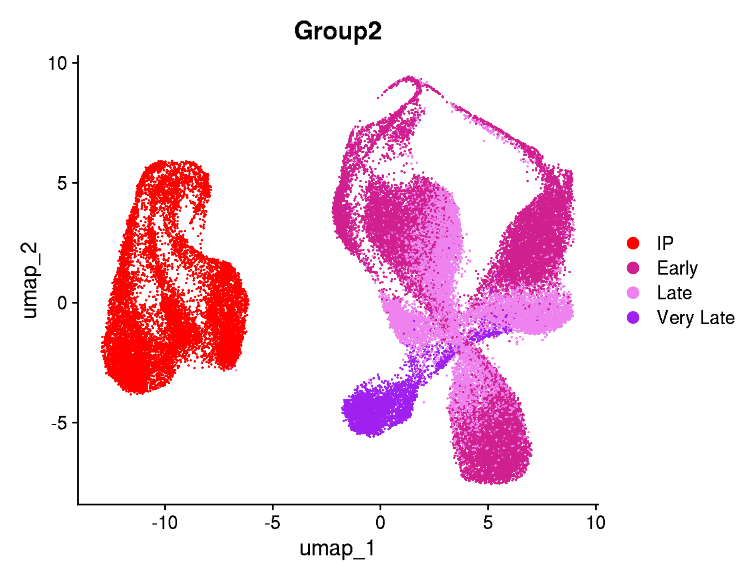
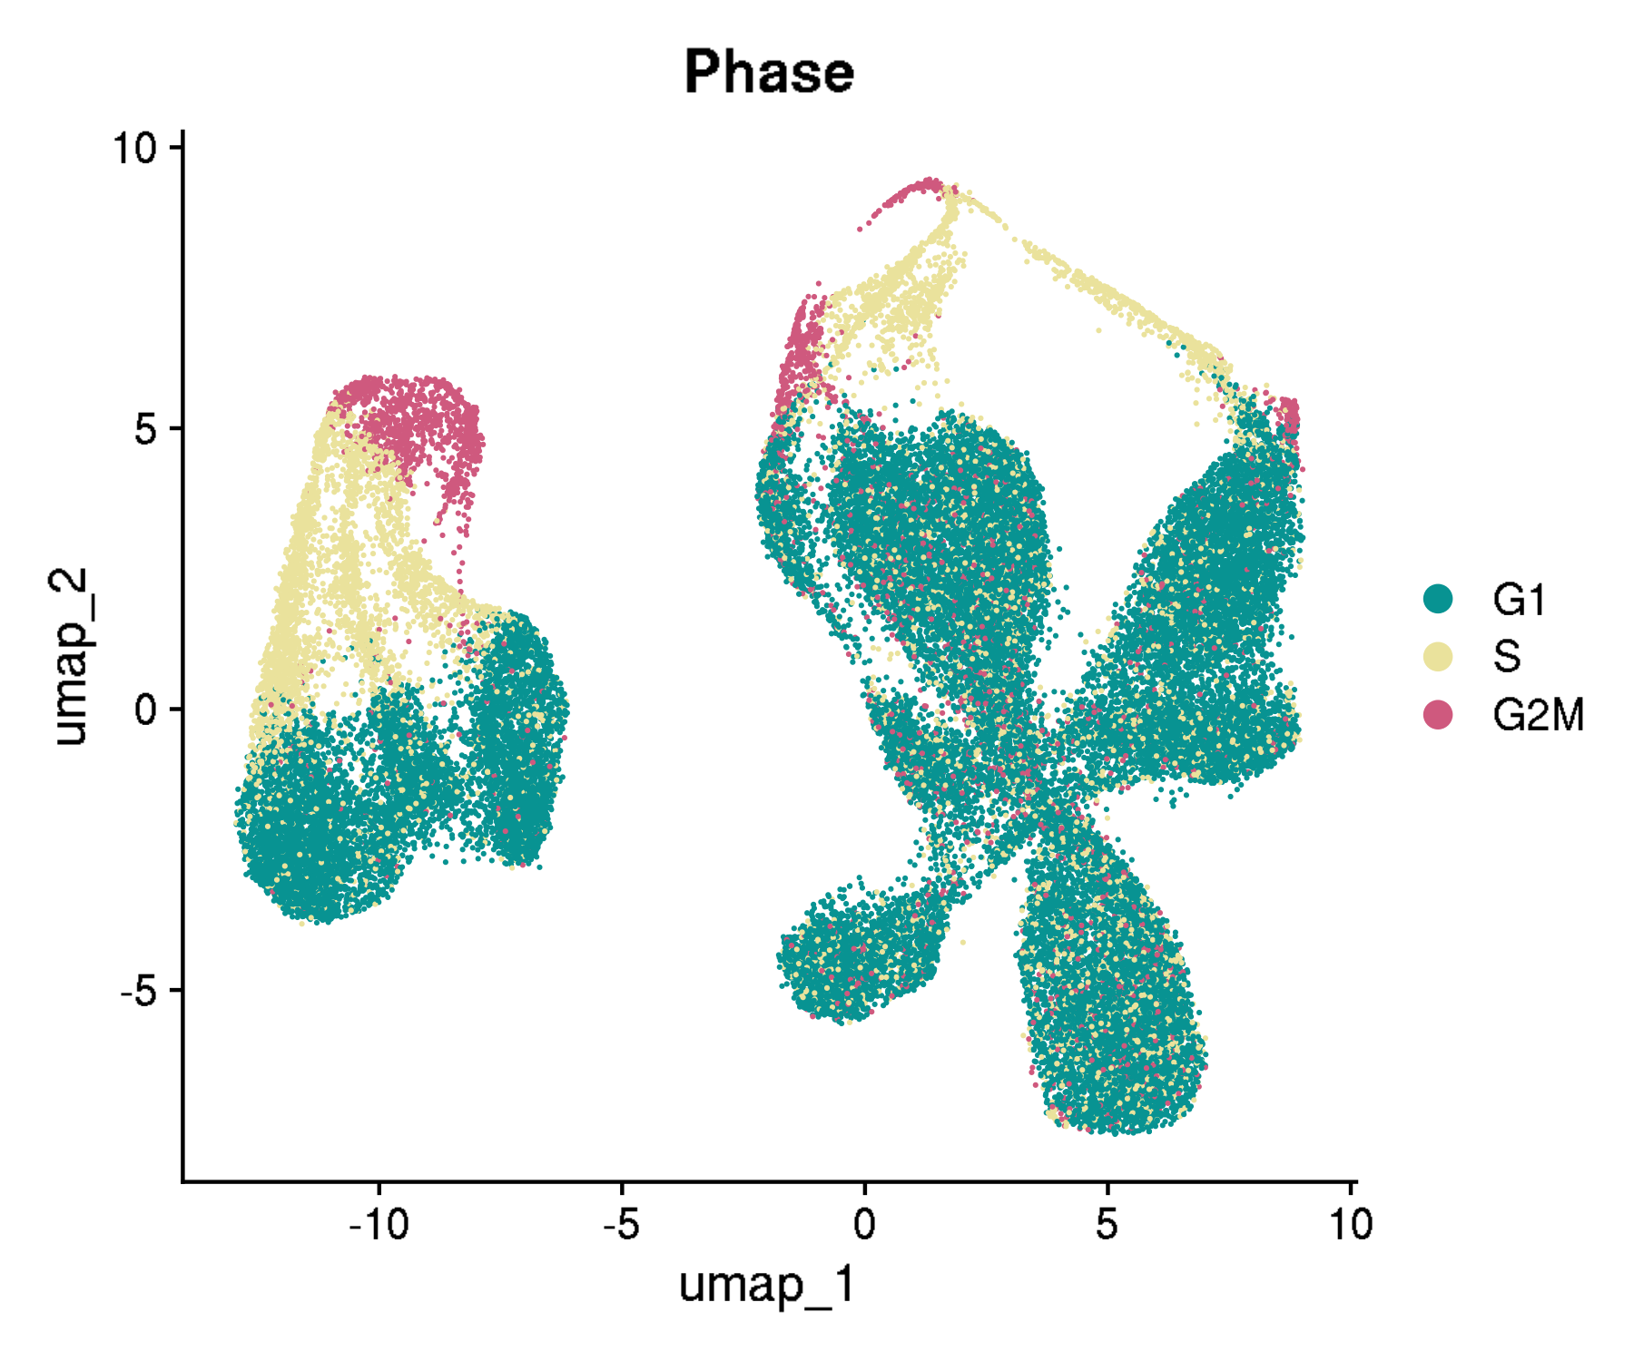
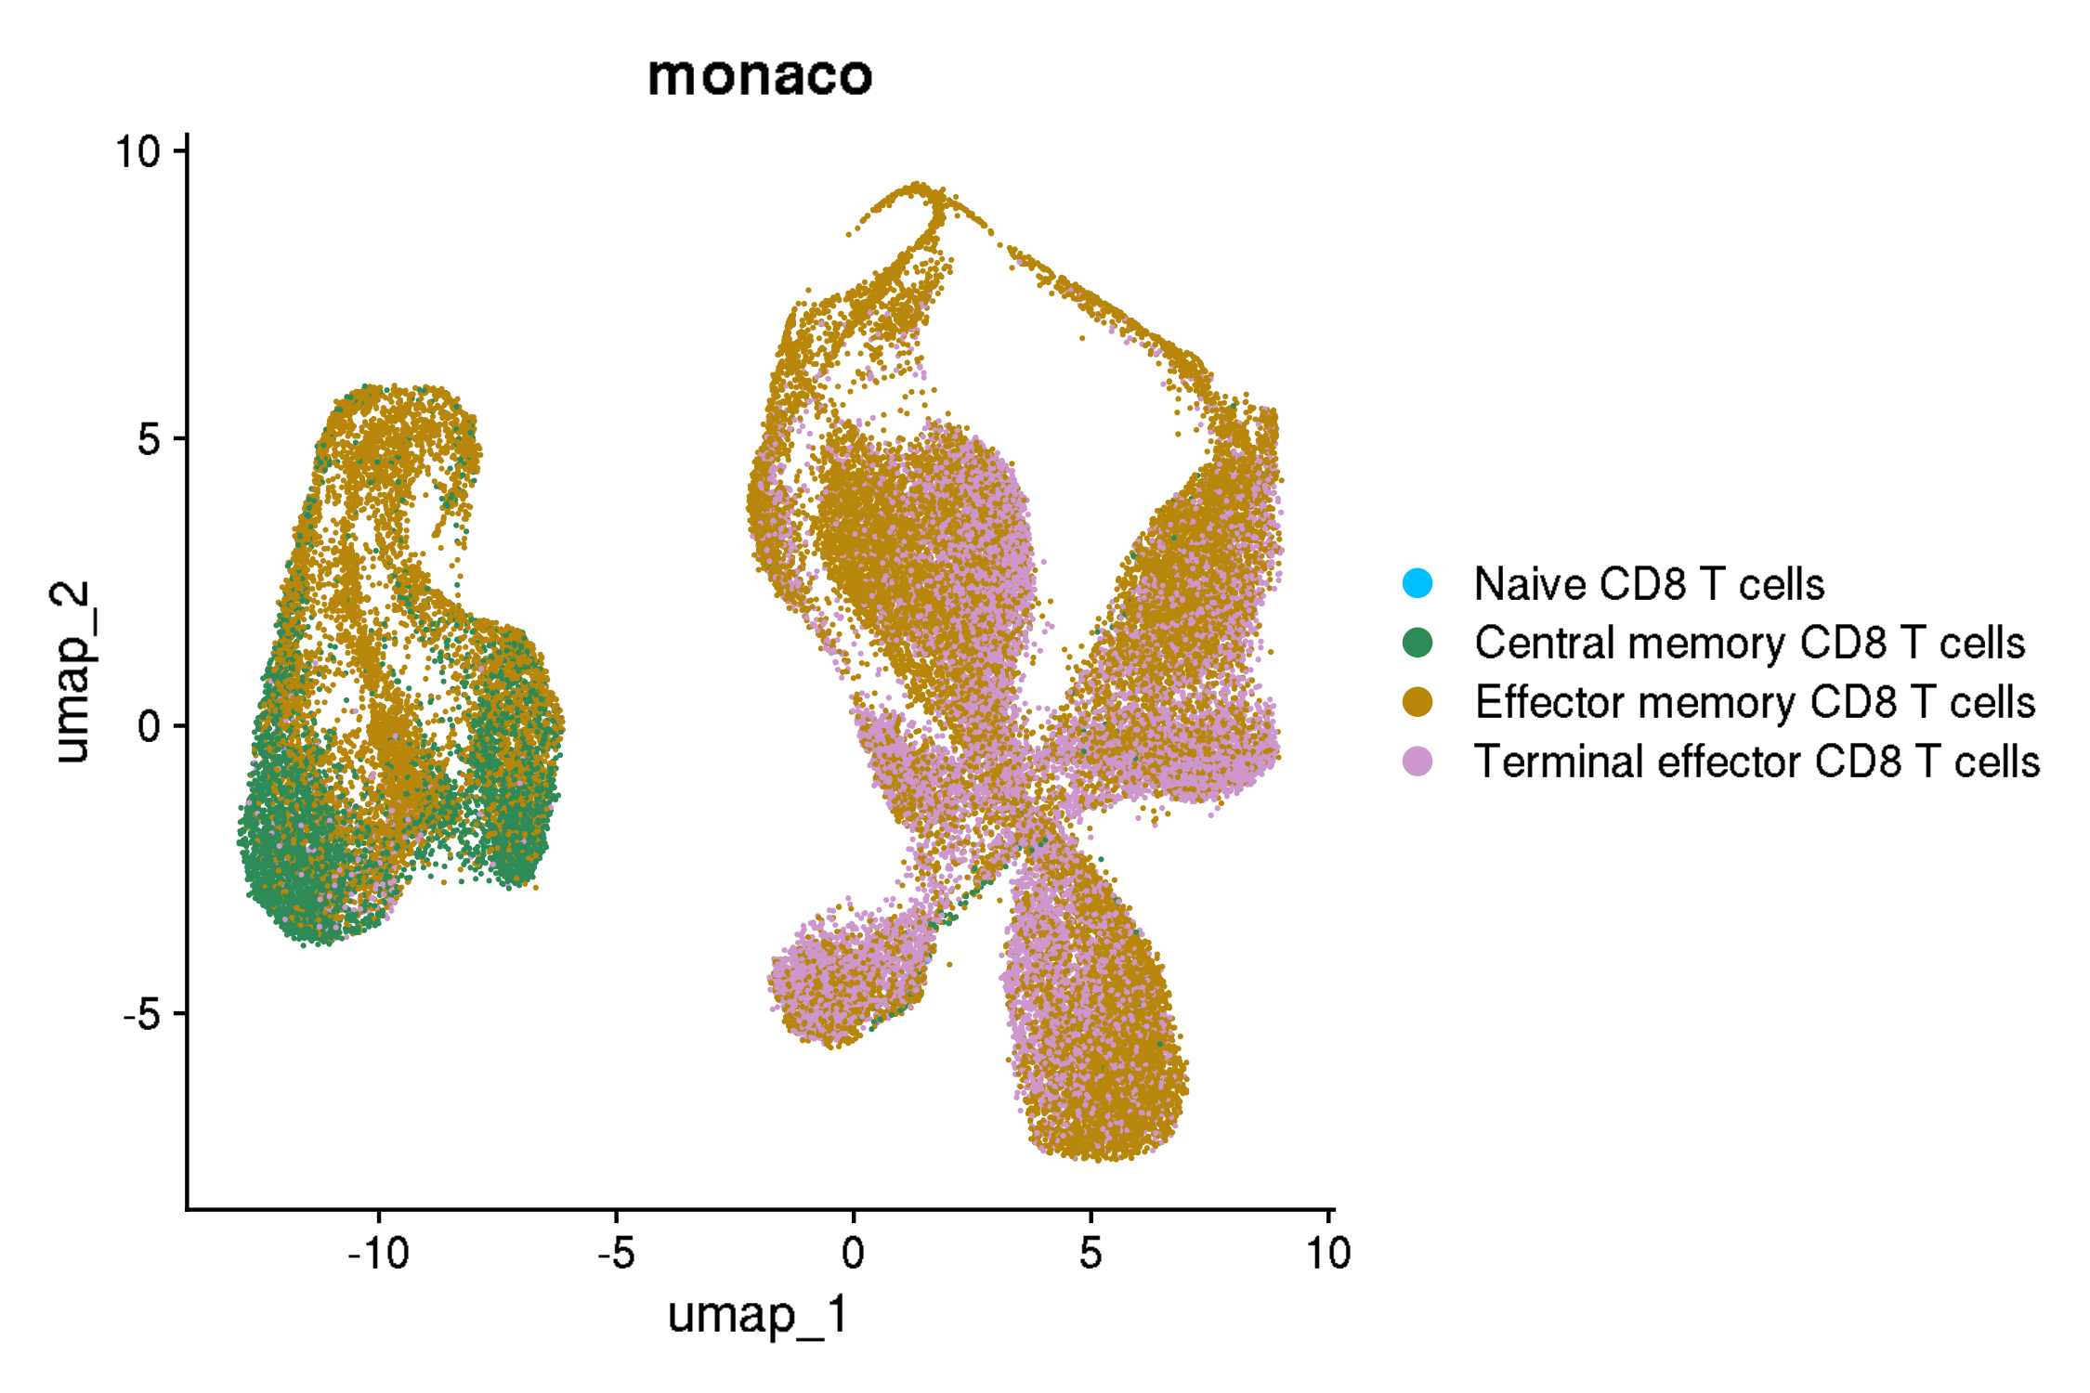
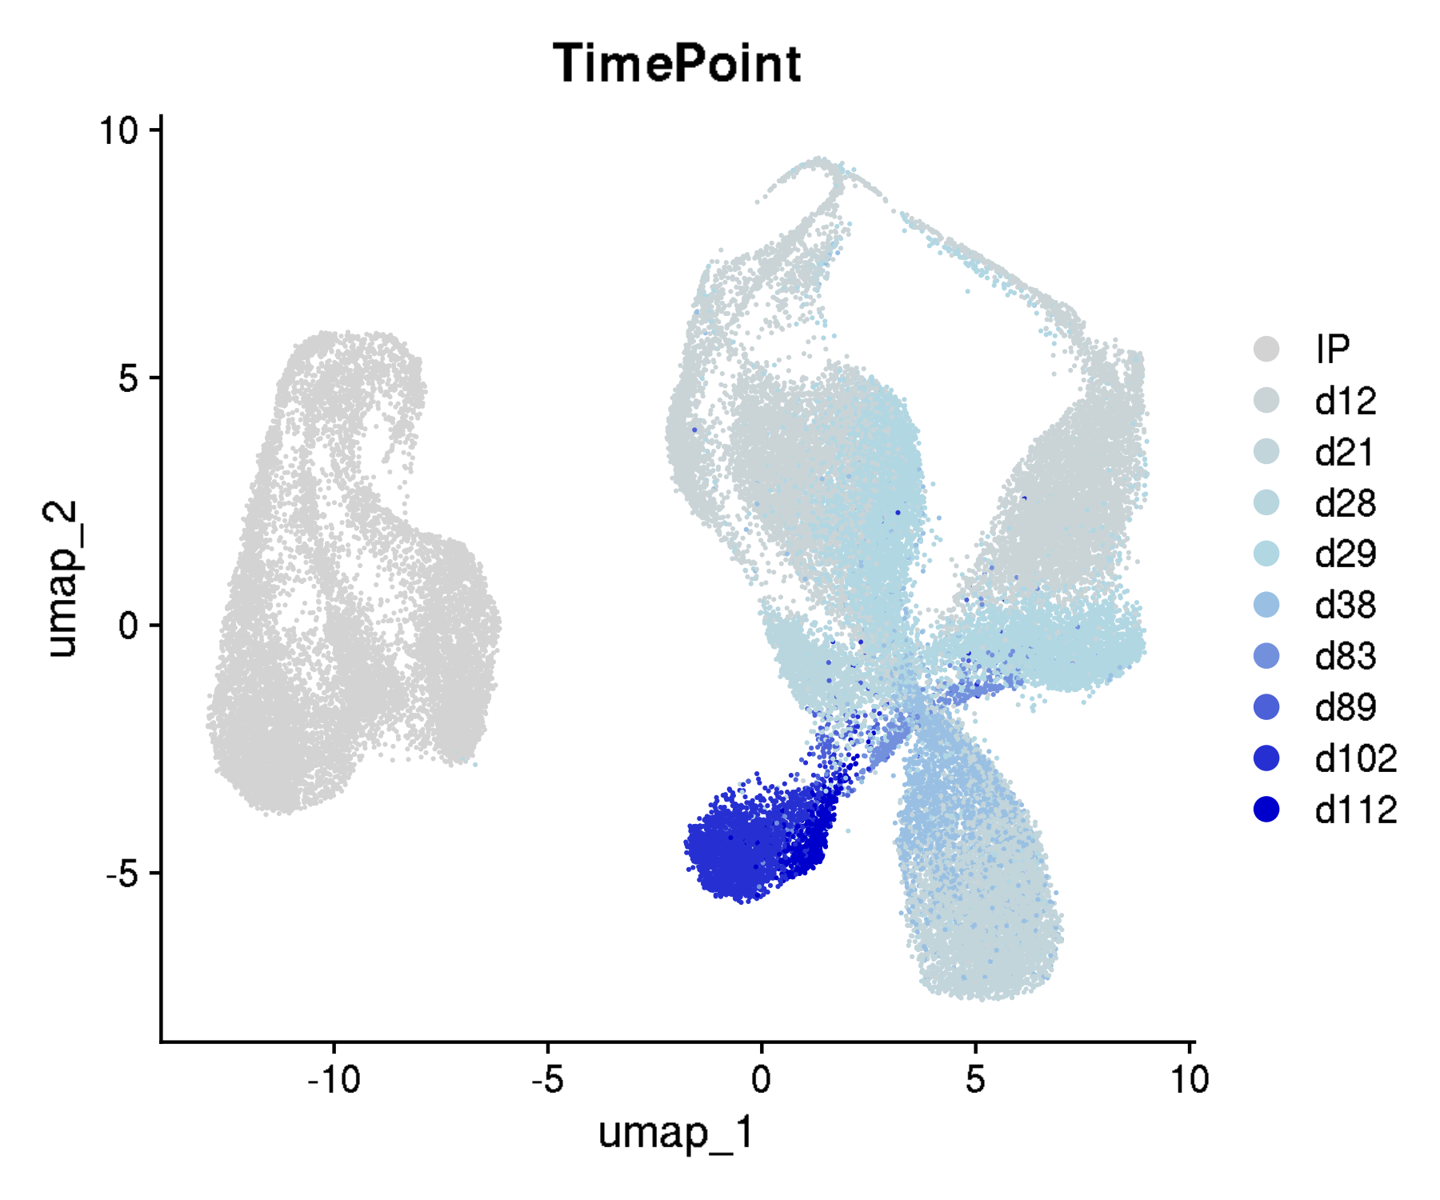
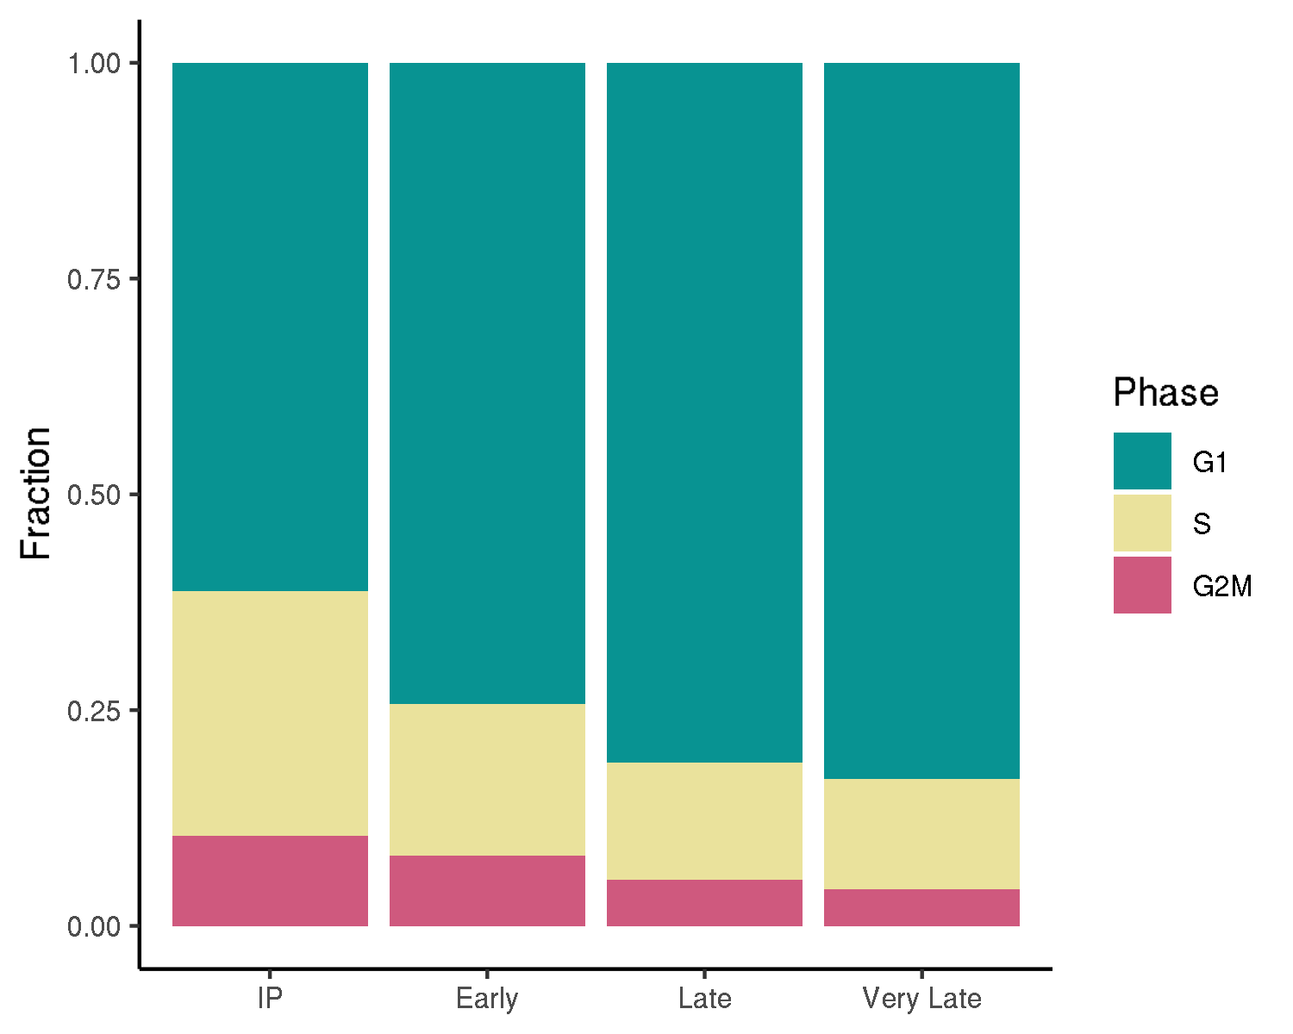
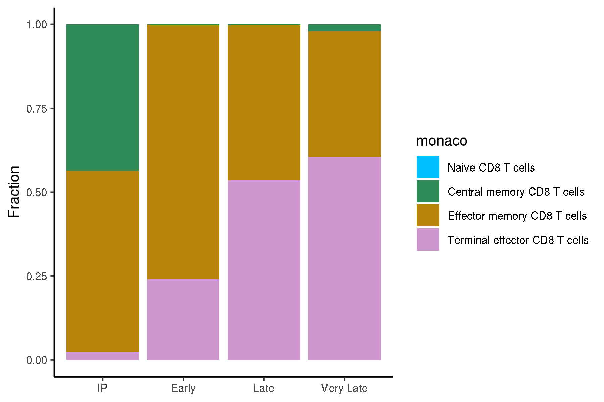
GSE125881: longitudinal kinetics of CD19 CAR T cells in cancer patients
UMAPs for cell annotations

Slide 3
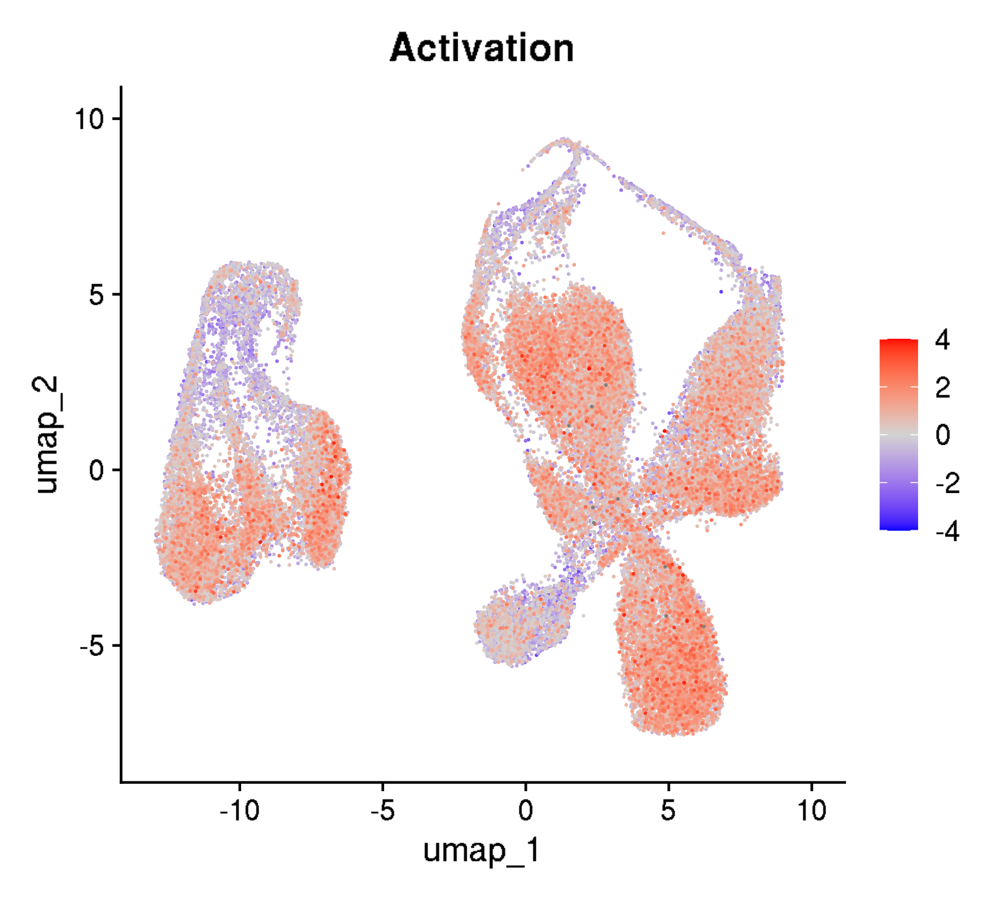
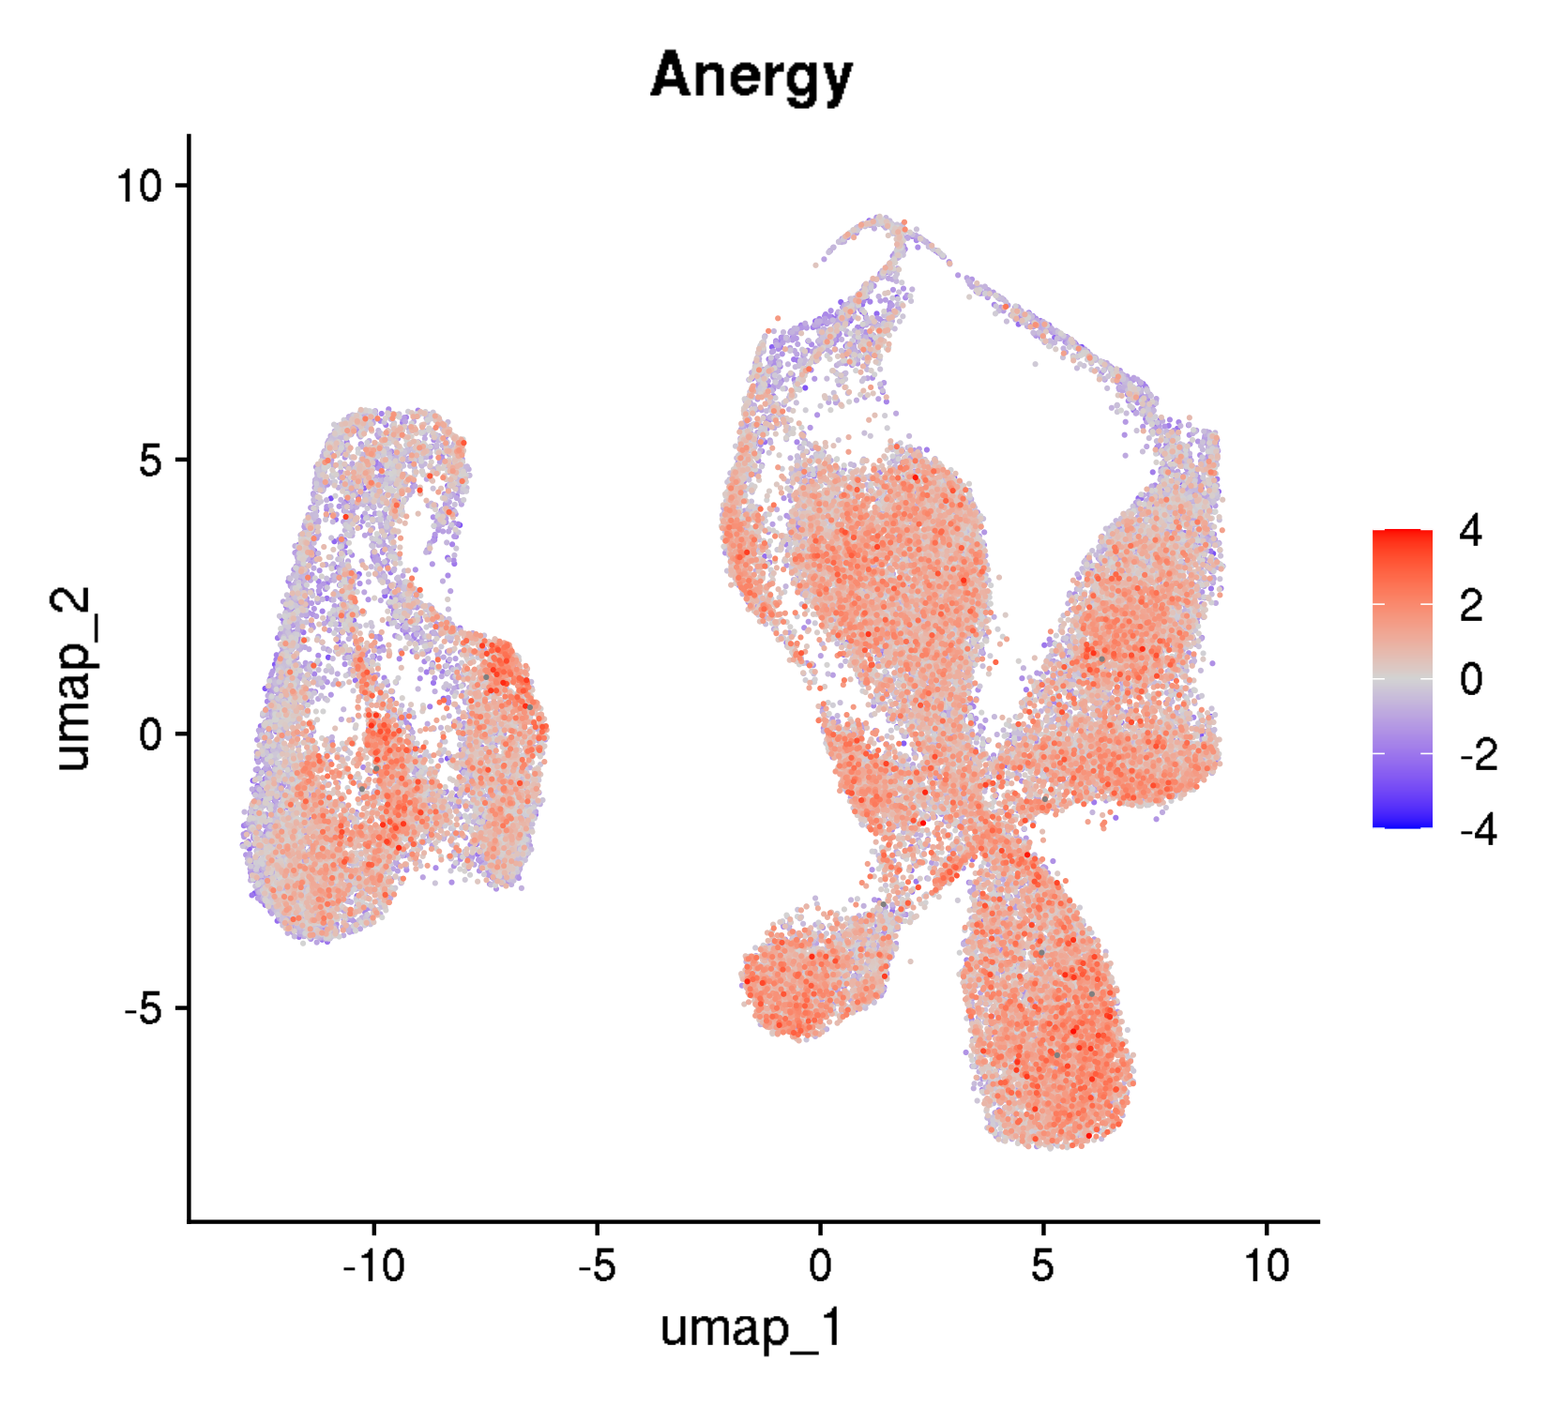
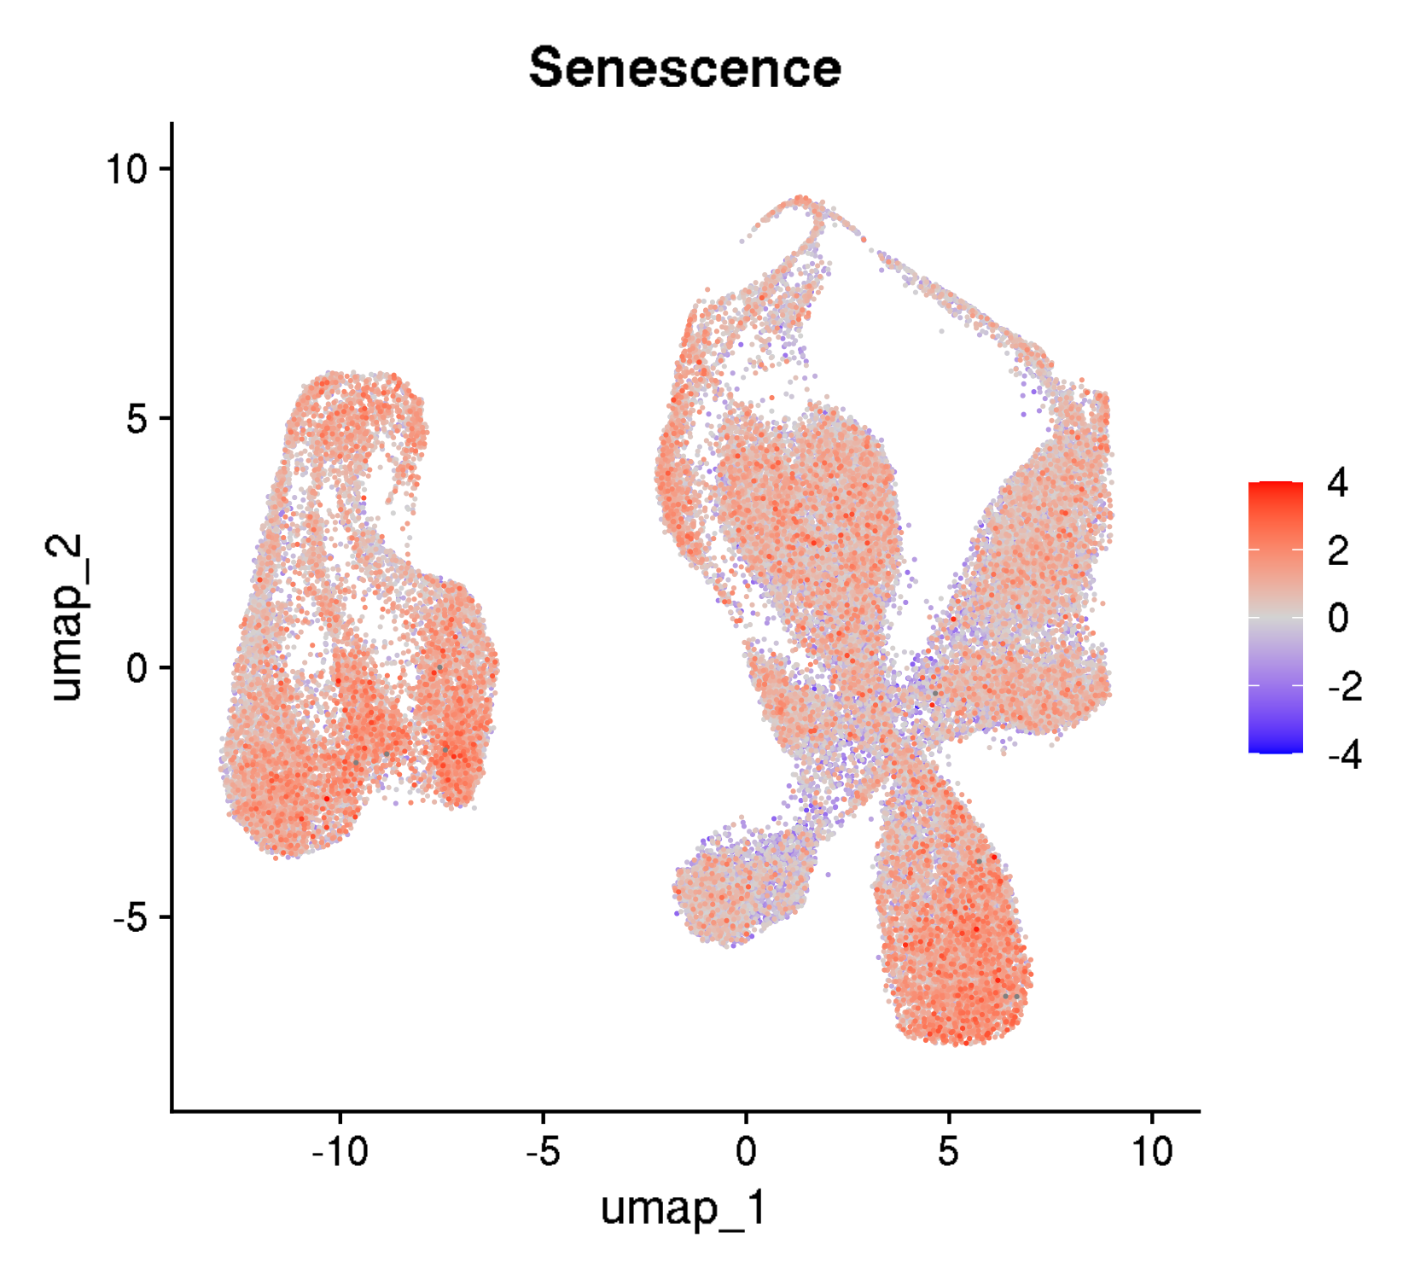

GSE125881: longitudinal kinetics of CD19 CAR T cells in cancer patients
UMAPs for cell states

Slide 4
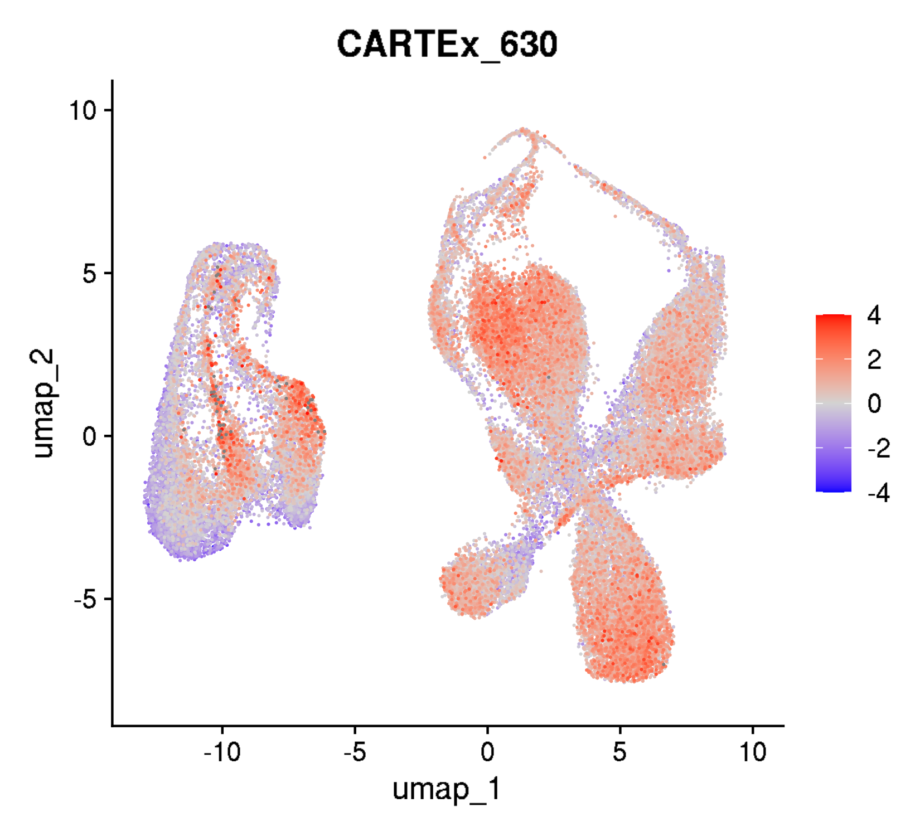
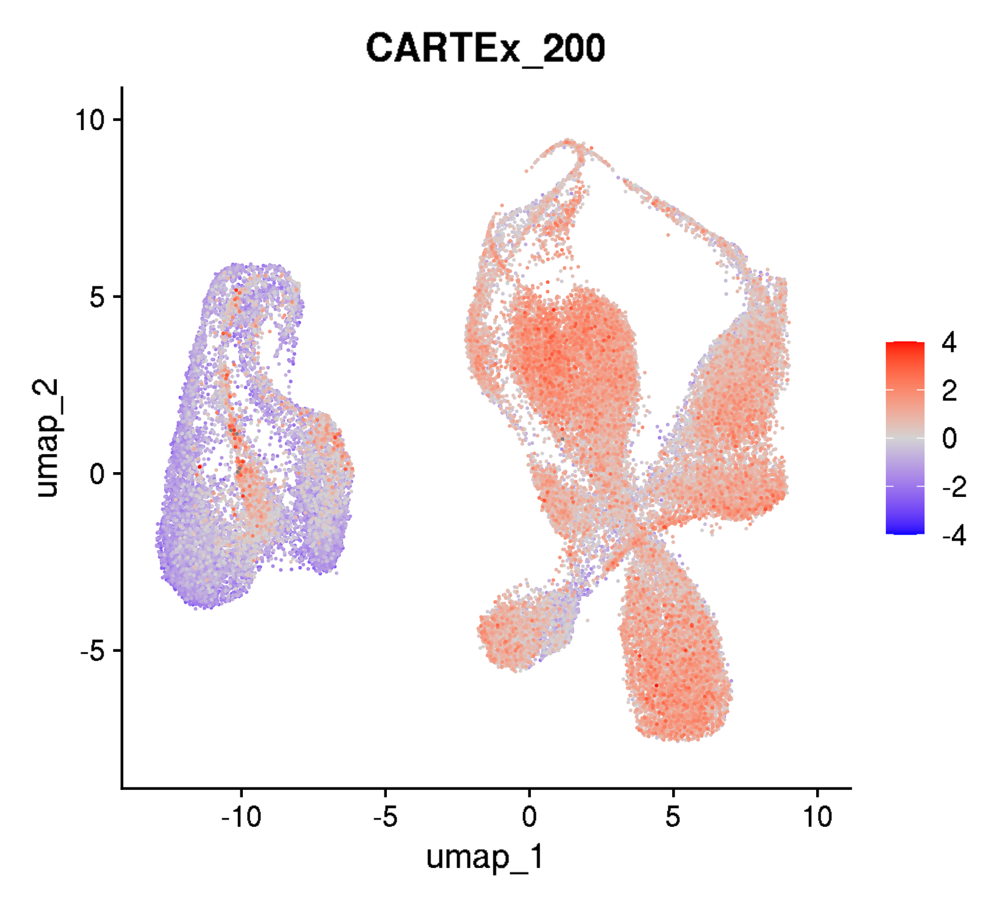

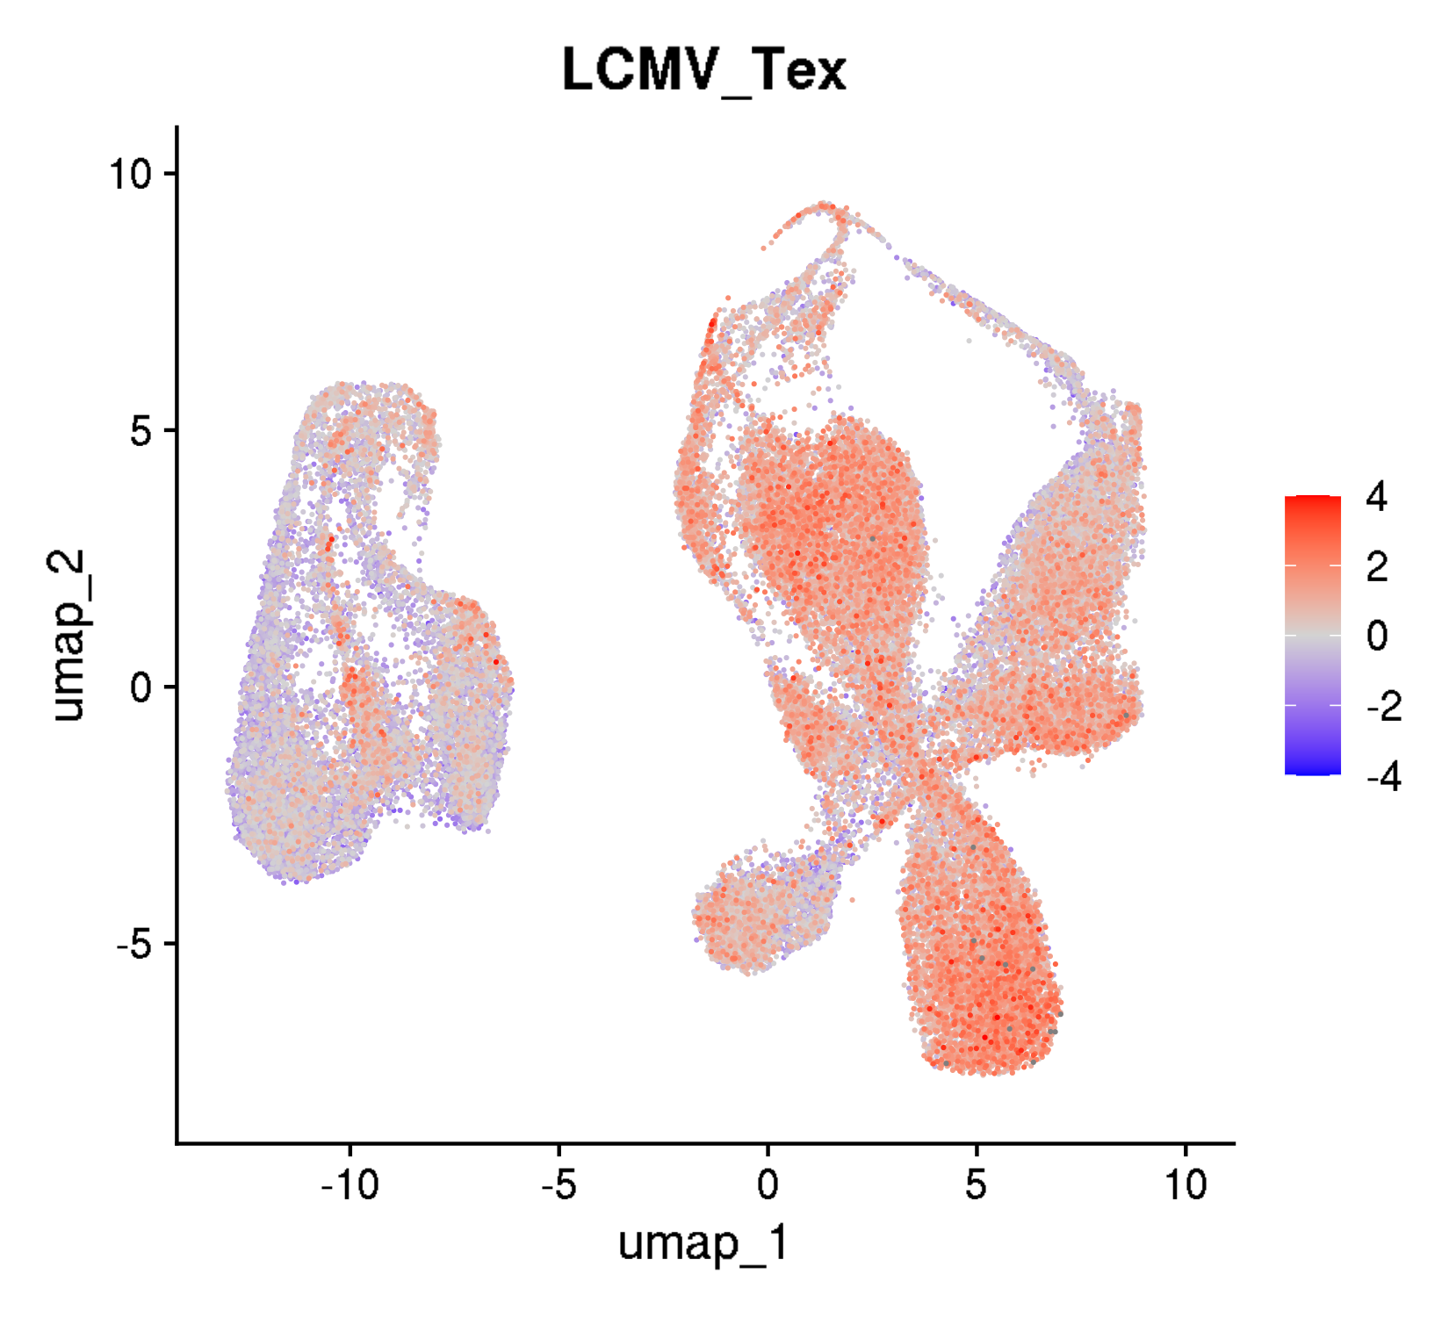
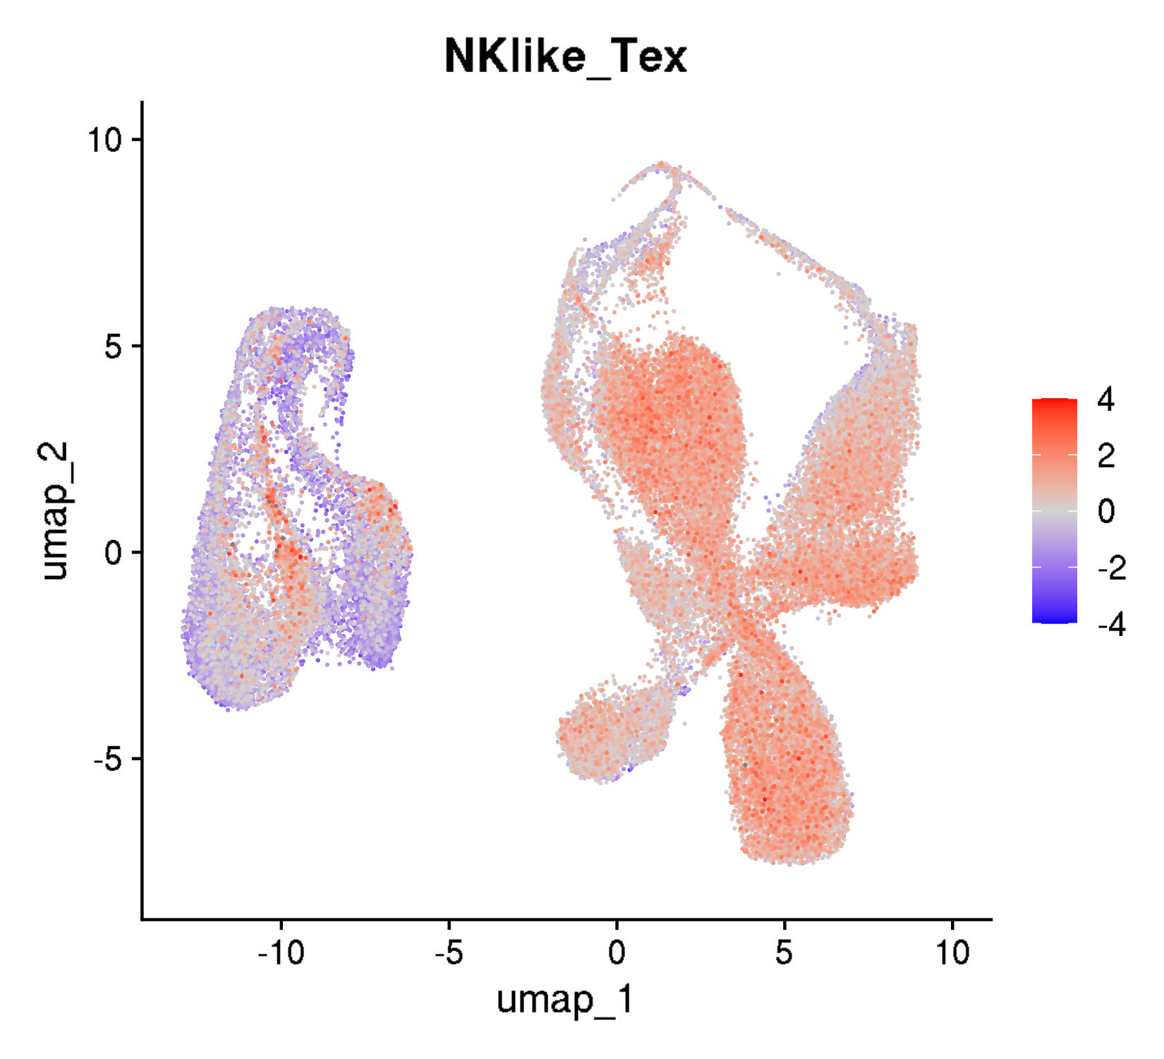
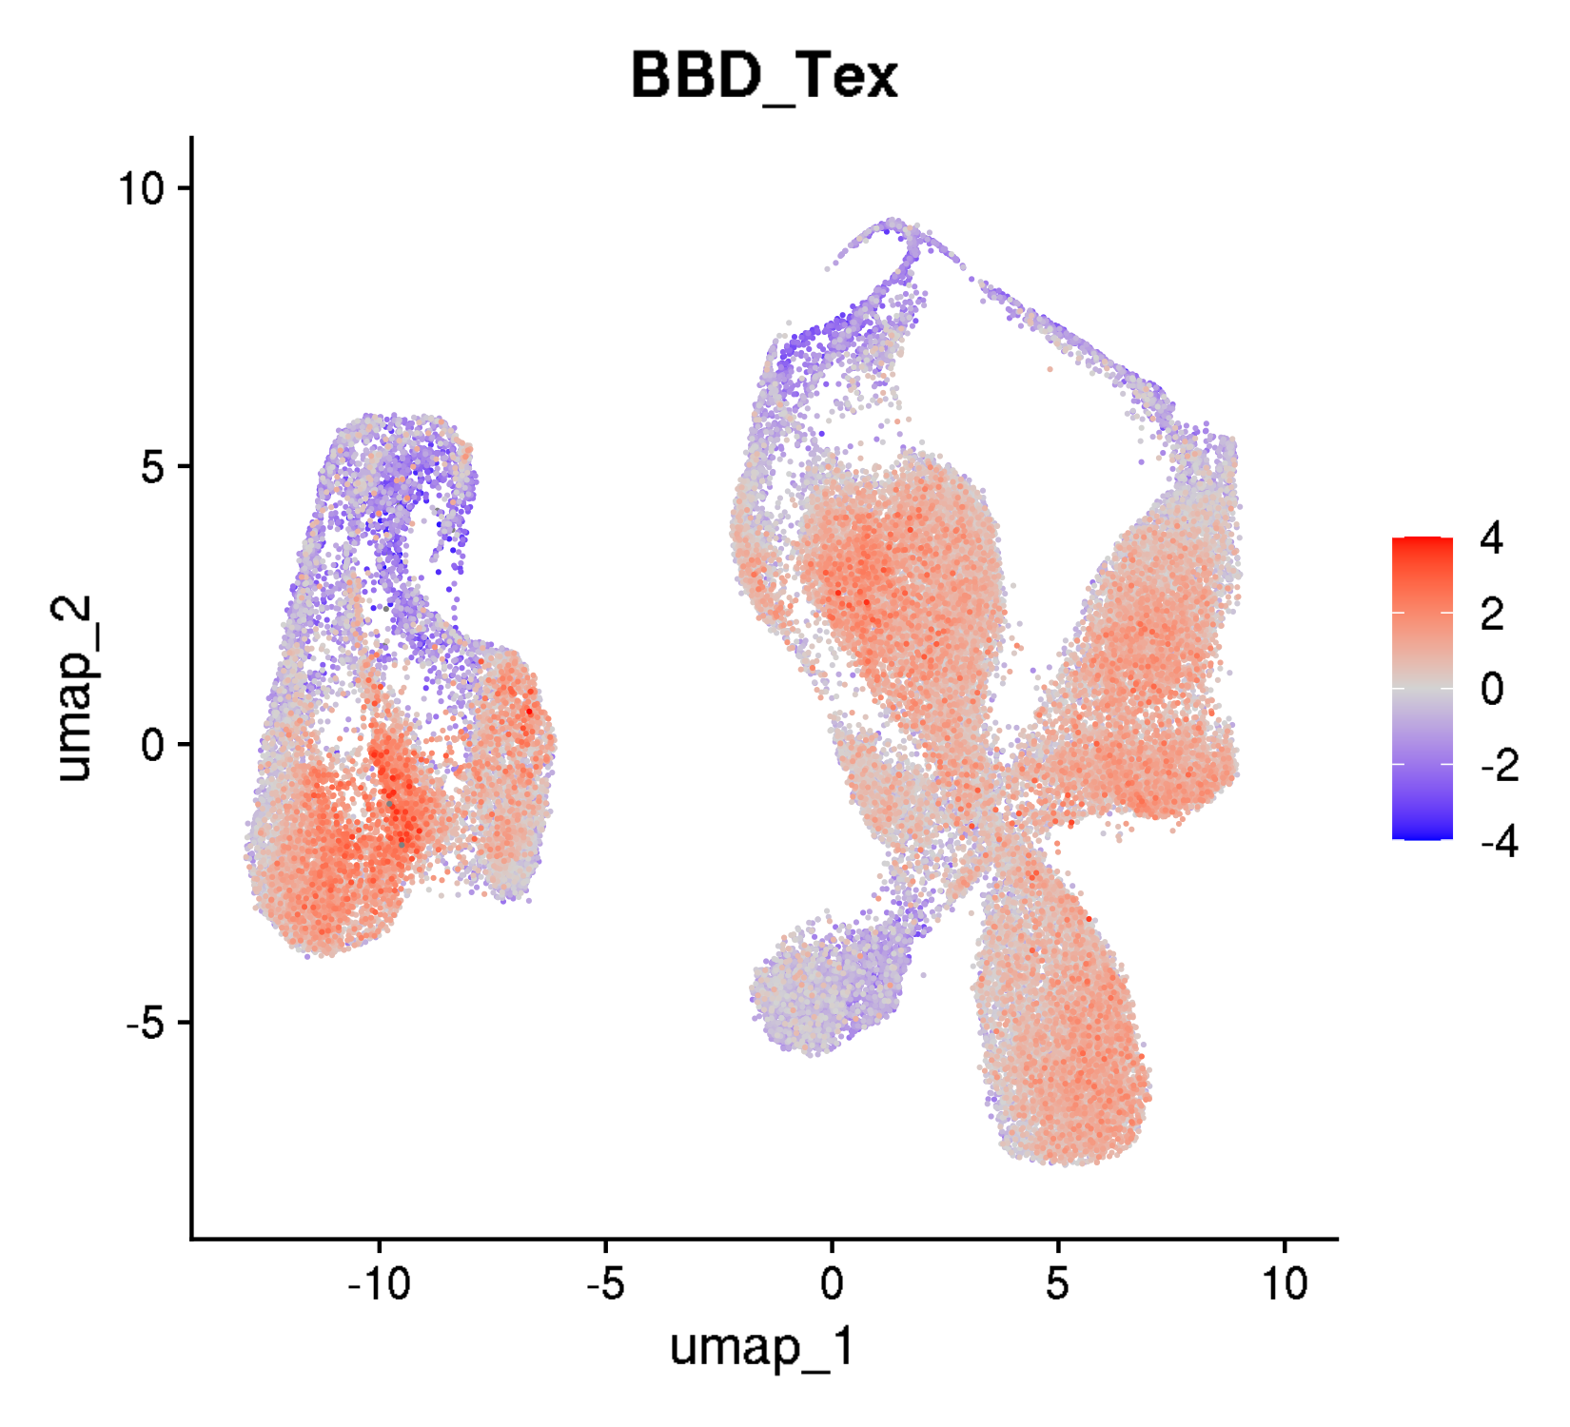
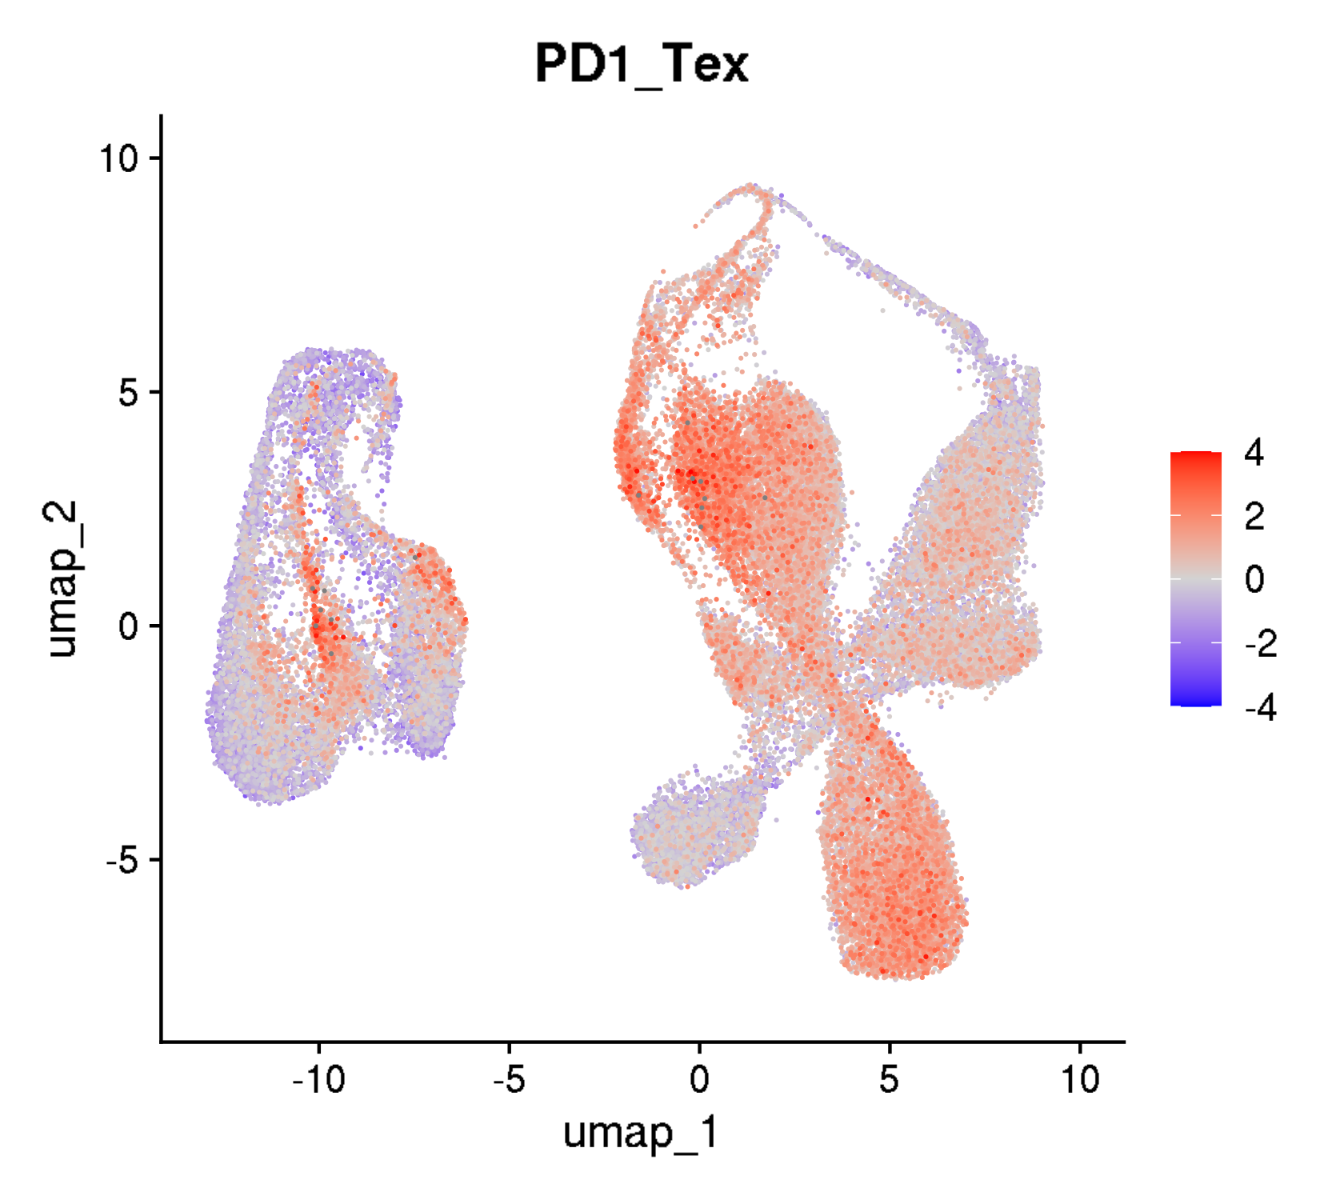
GSE125881: longitudinal kinetics of CD19 CAR T cells in cancer patients
UMAPs for exhaustion scores

Slide 5
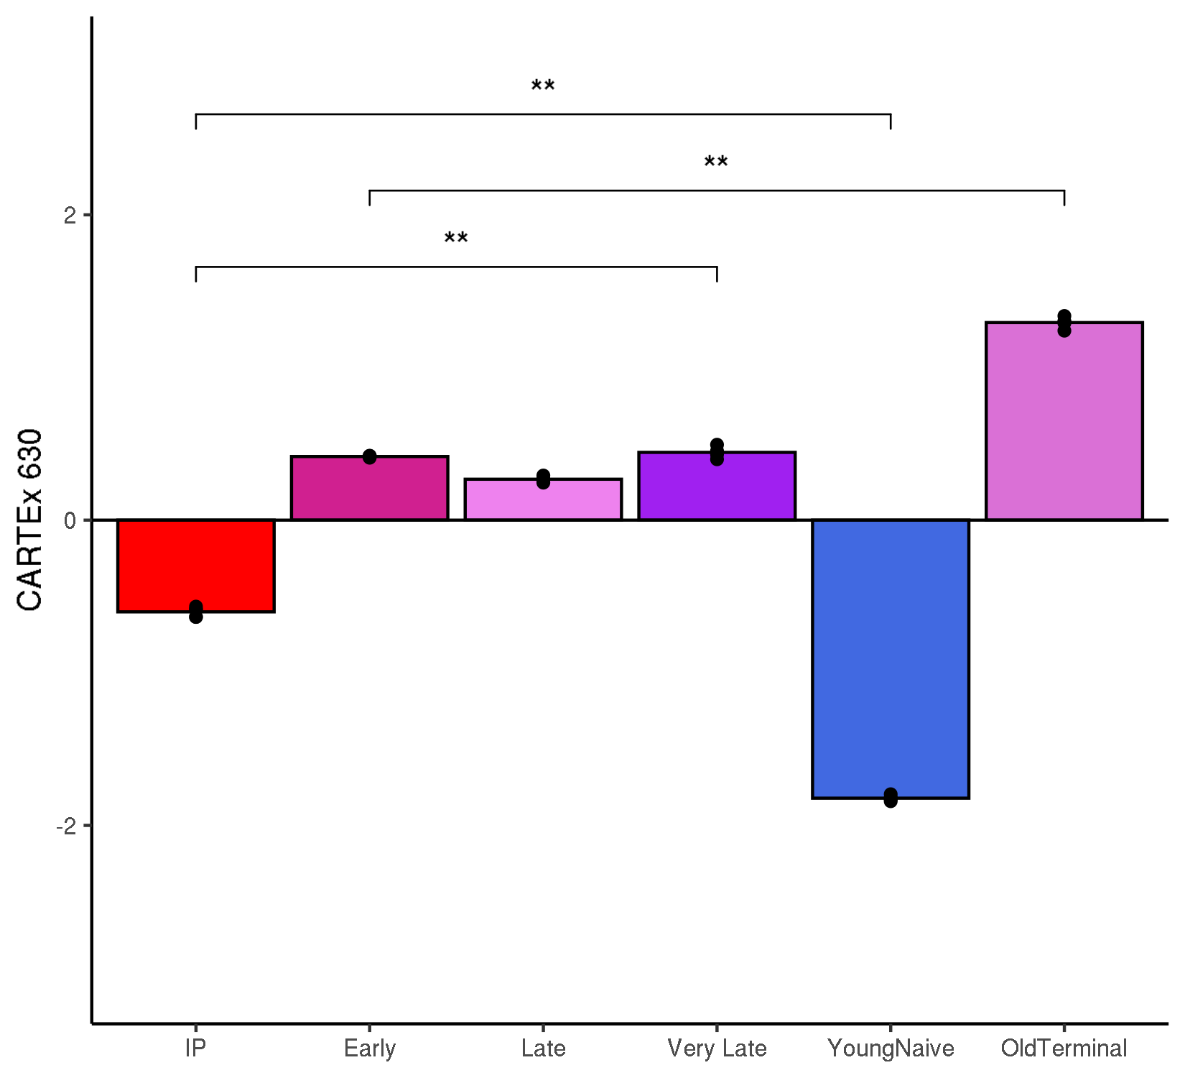
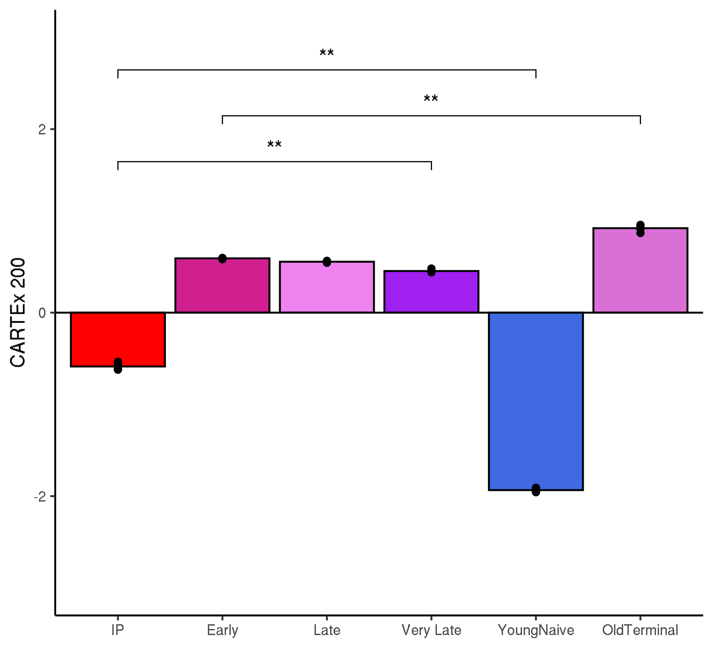
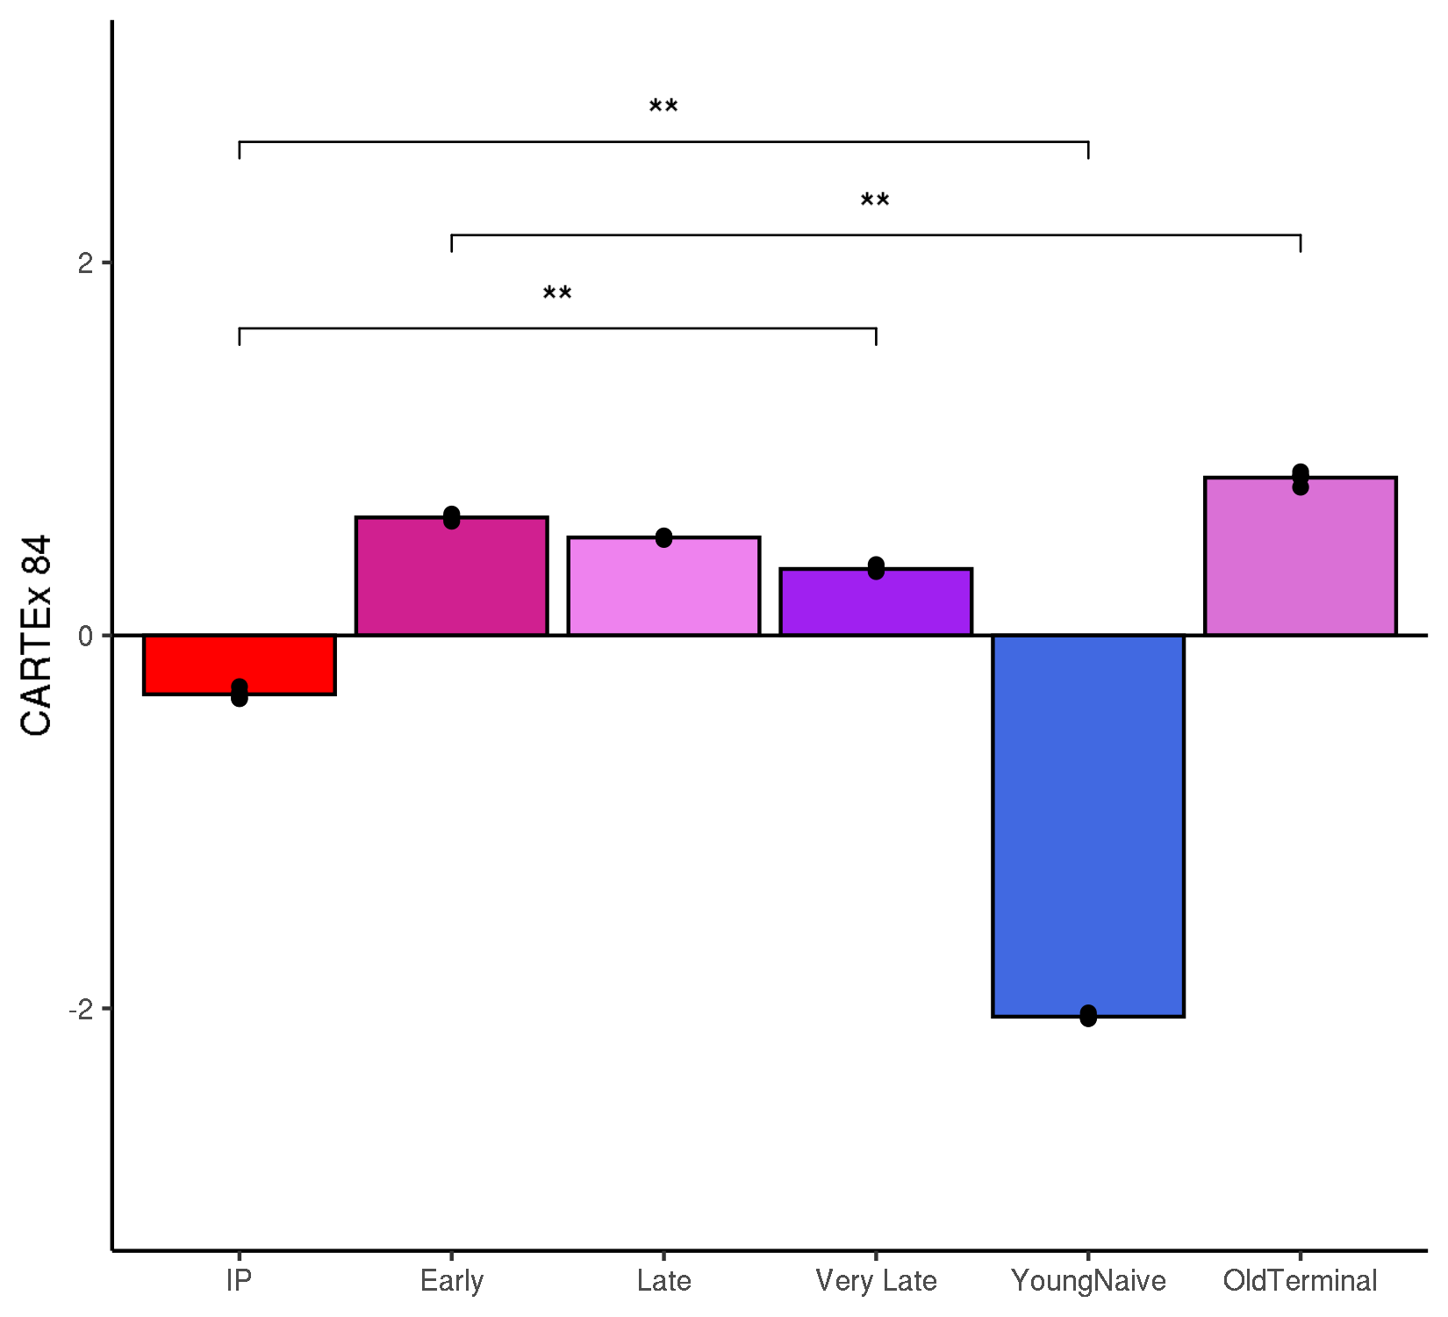
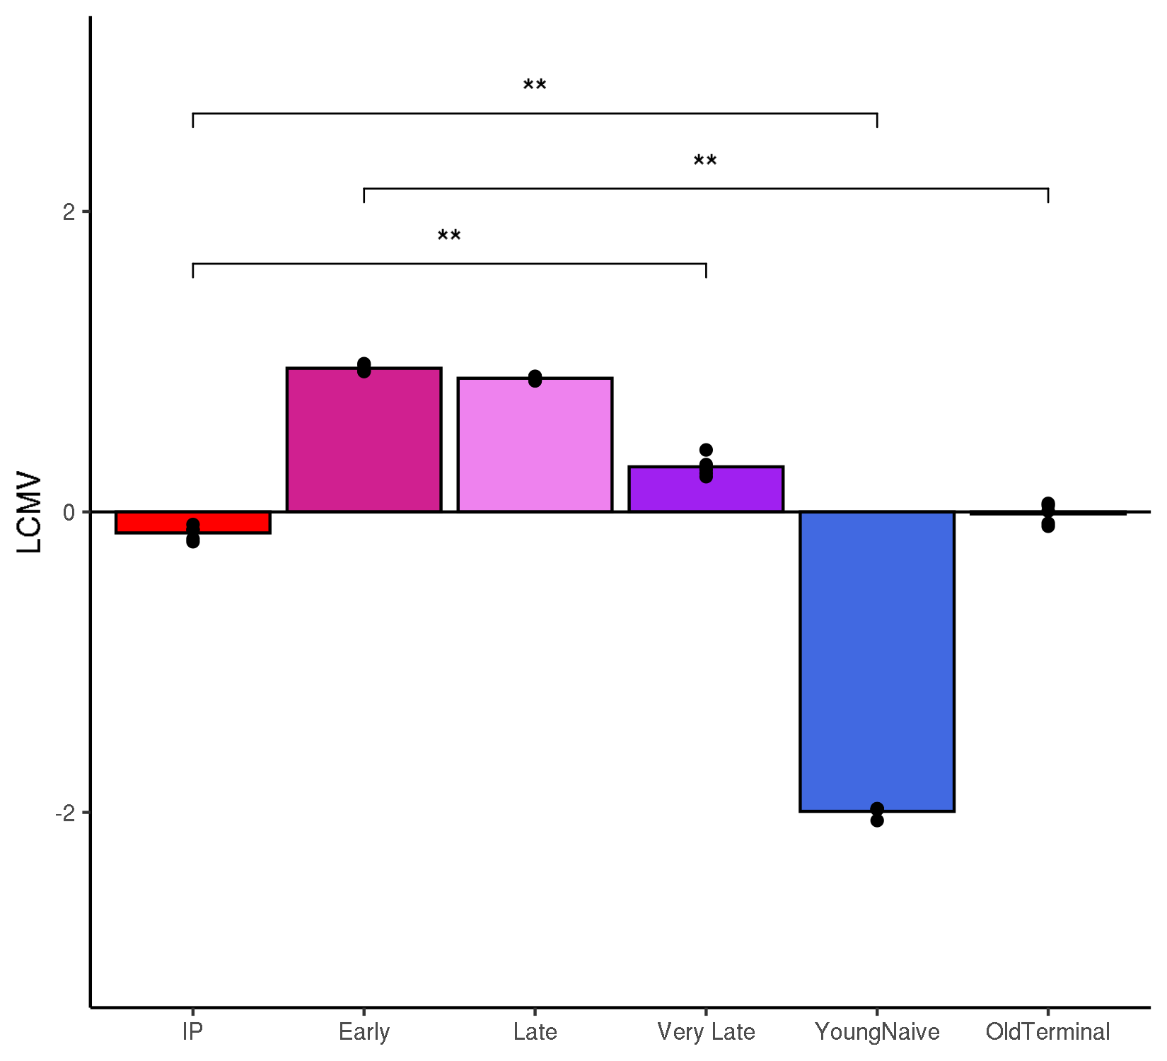
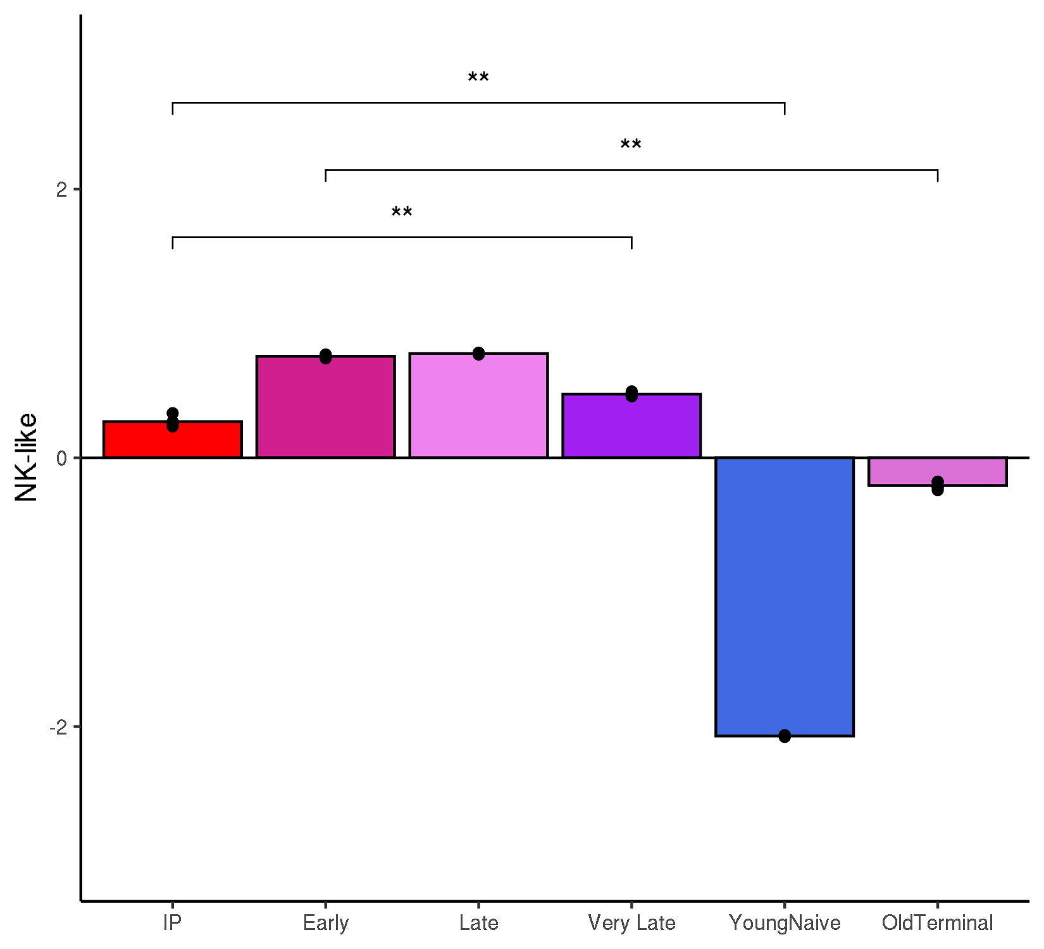
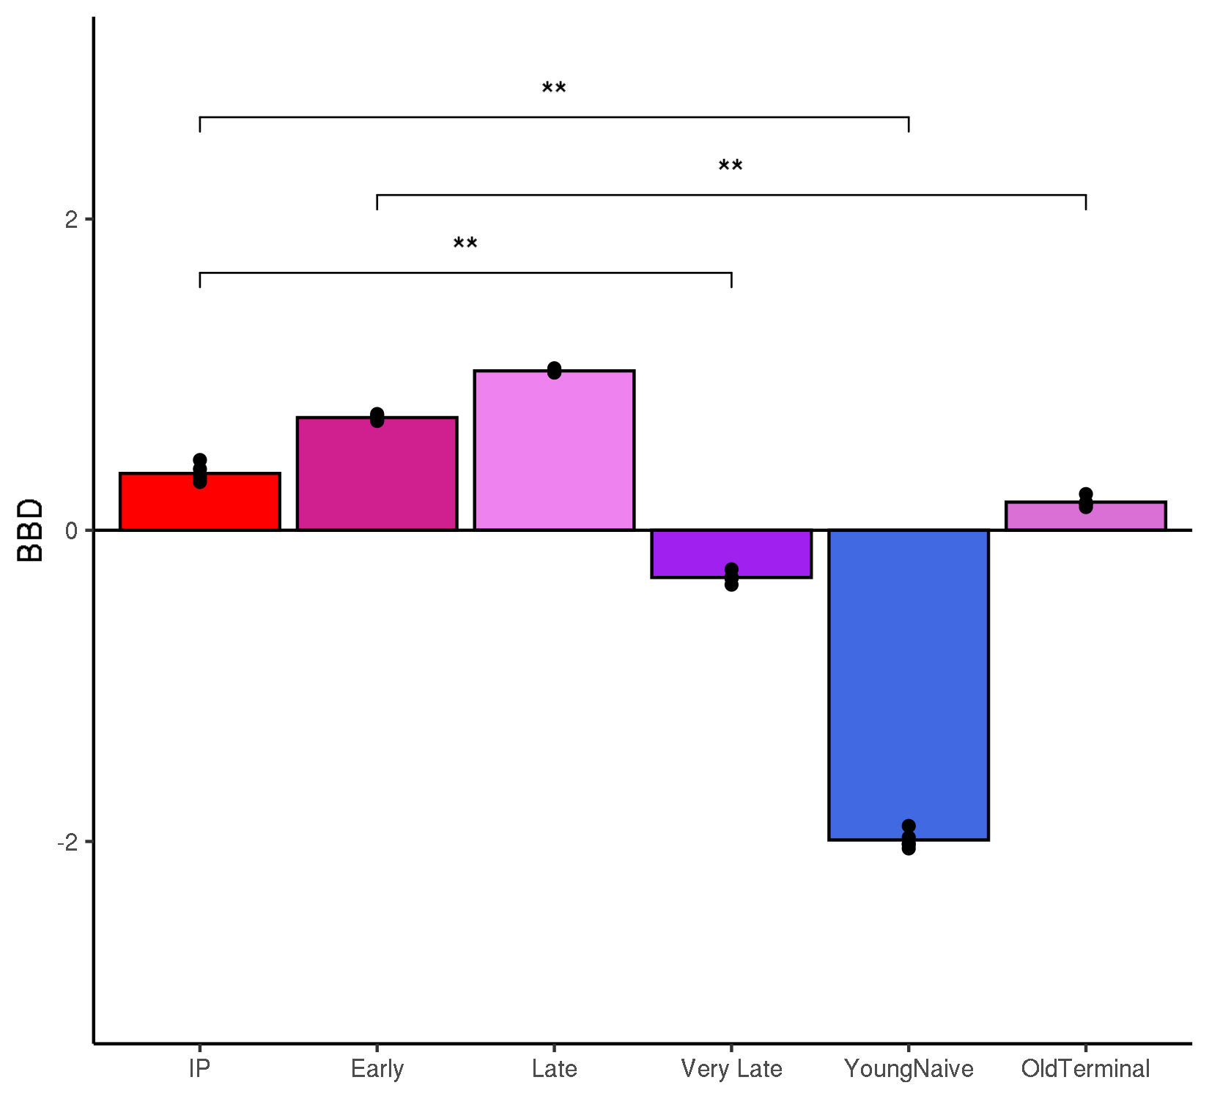
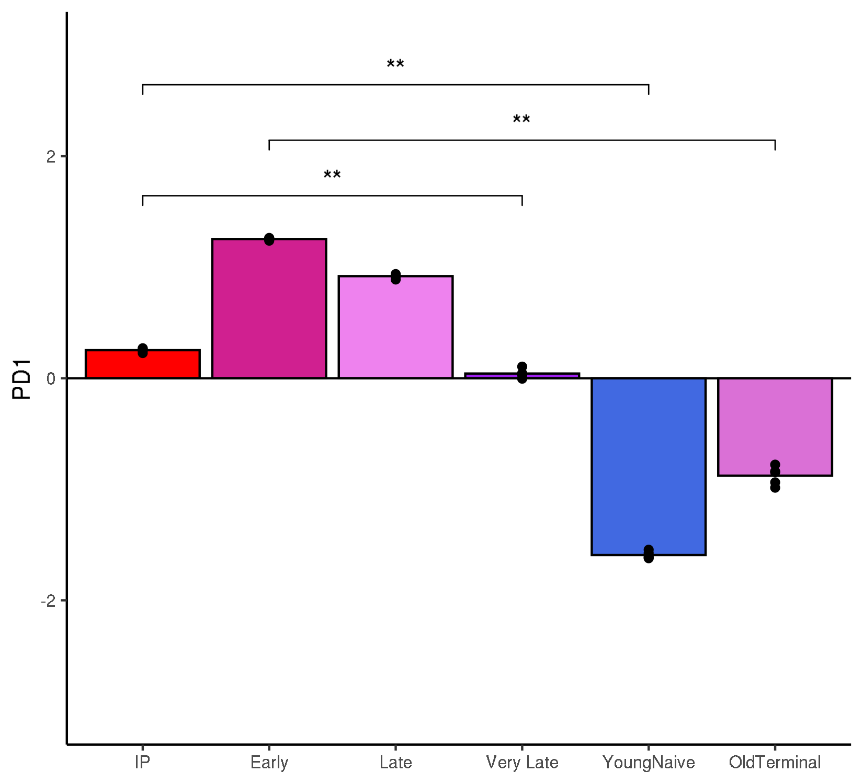
GSE125881: longitudinal kinetics of CD19 CAR T cells in cancer patients
Pseudo-bulk exhaustion scores

Slide 6
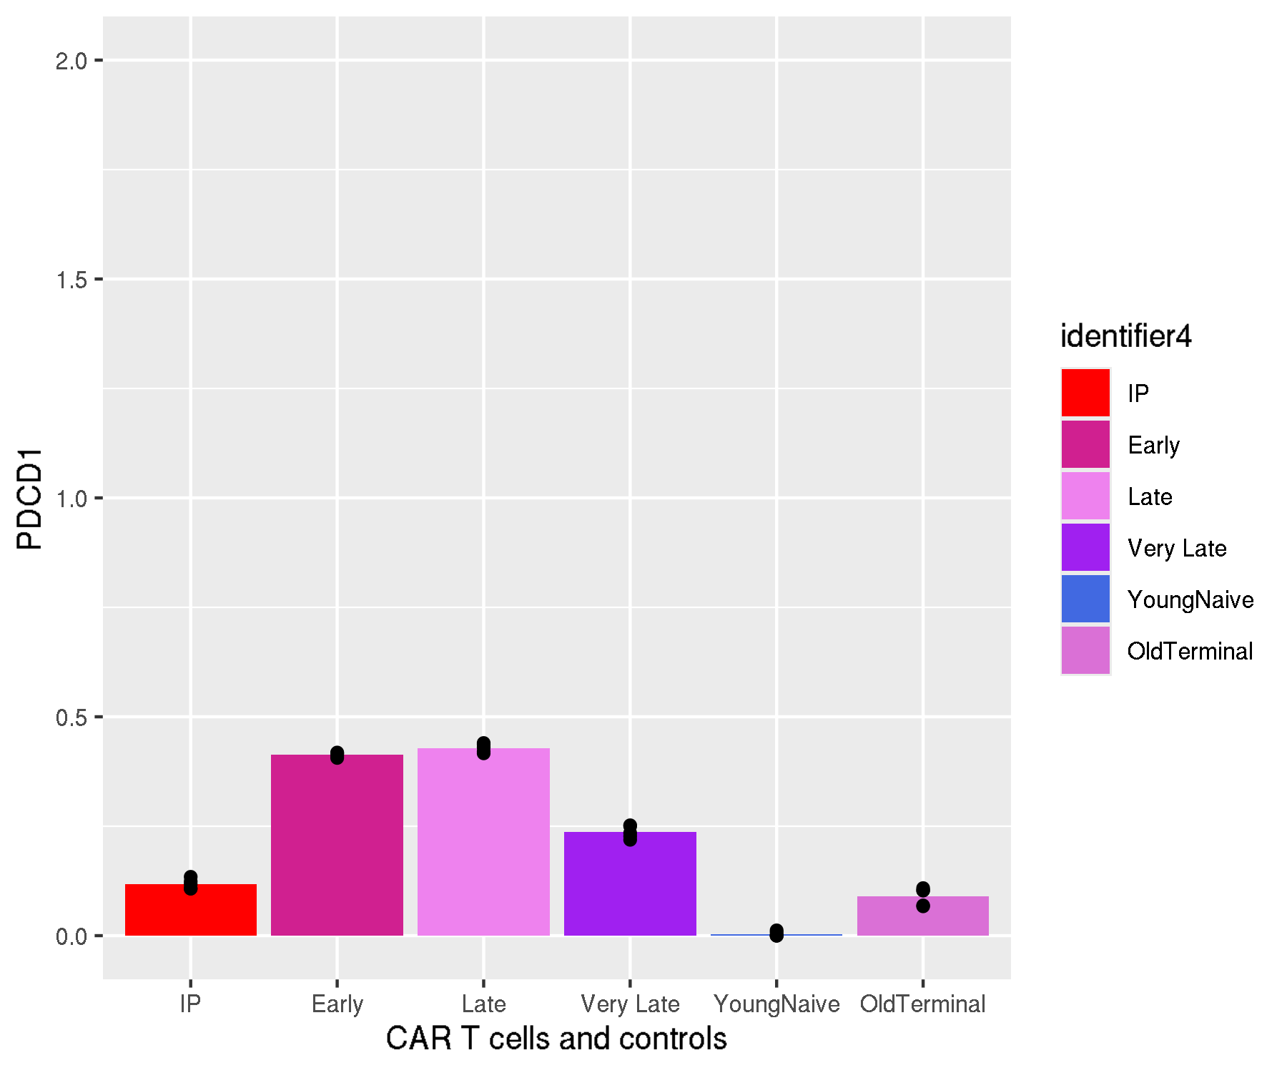
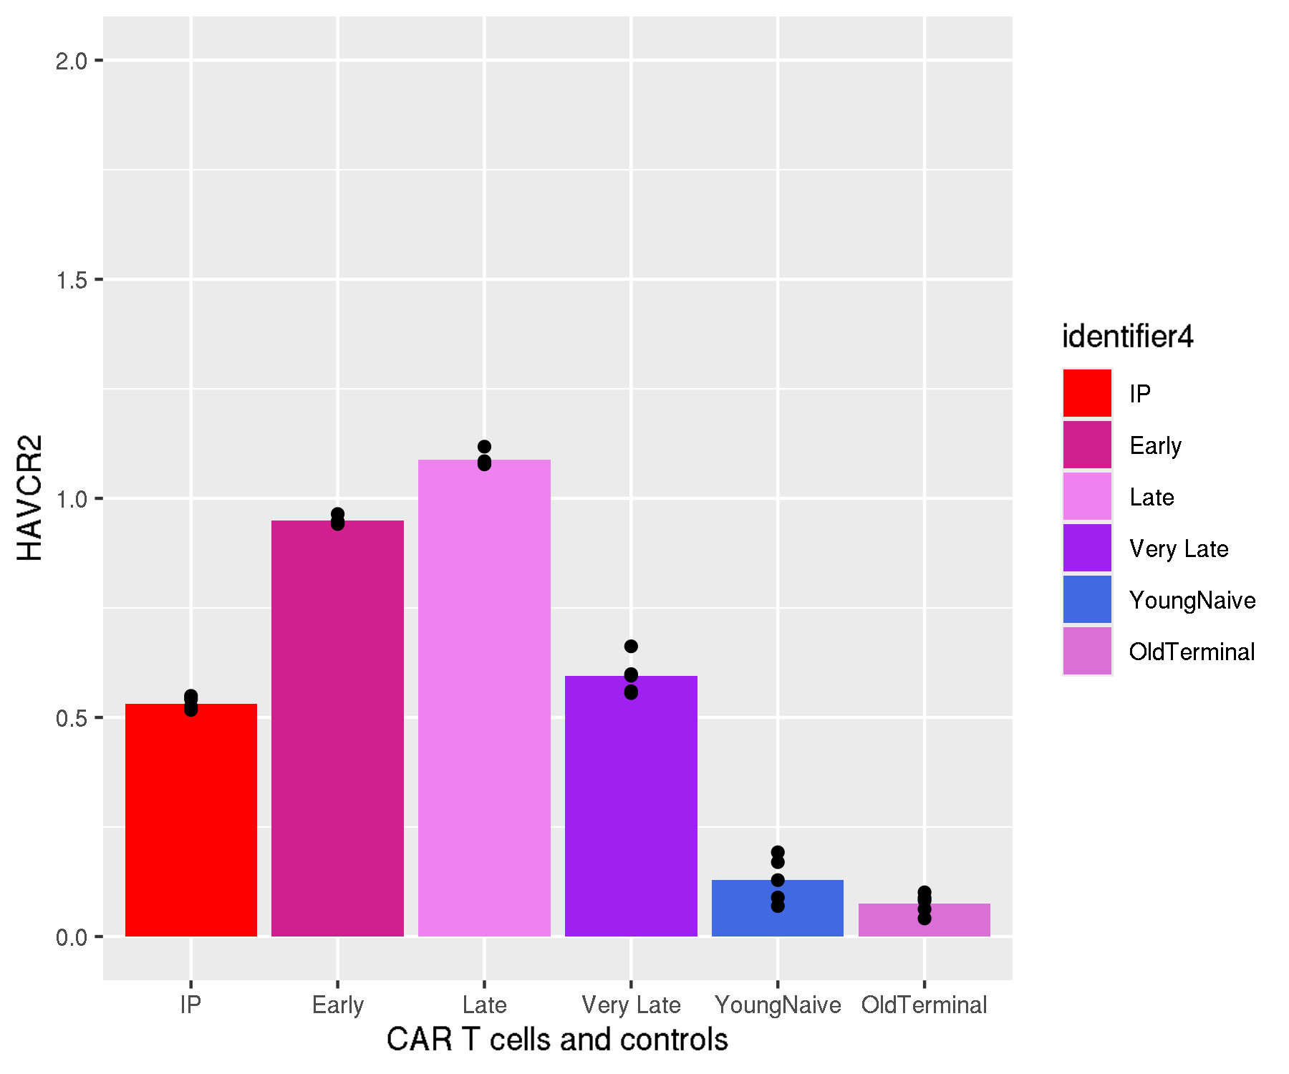
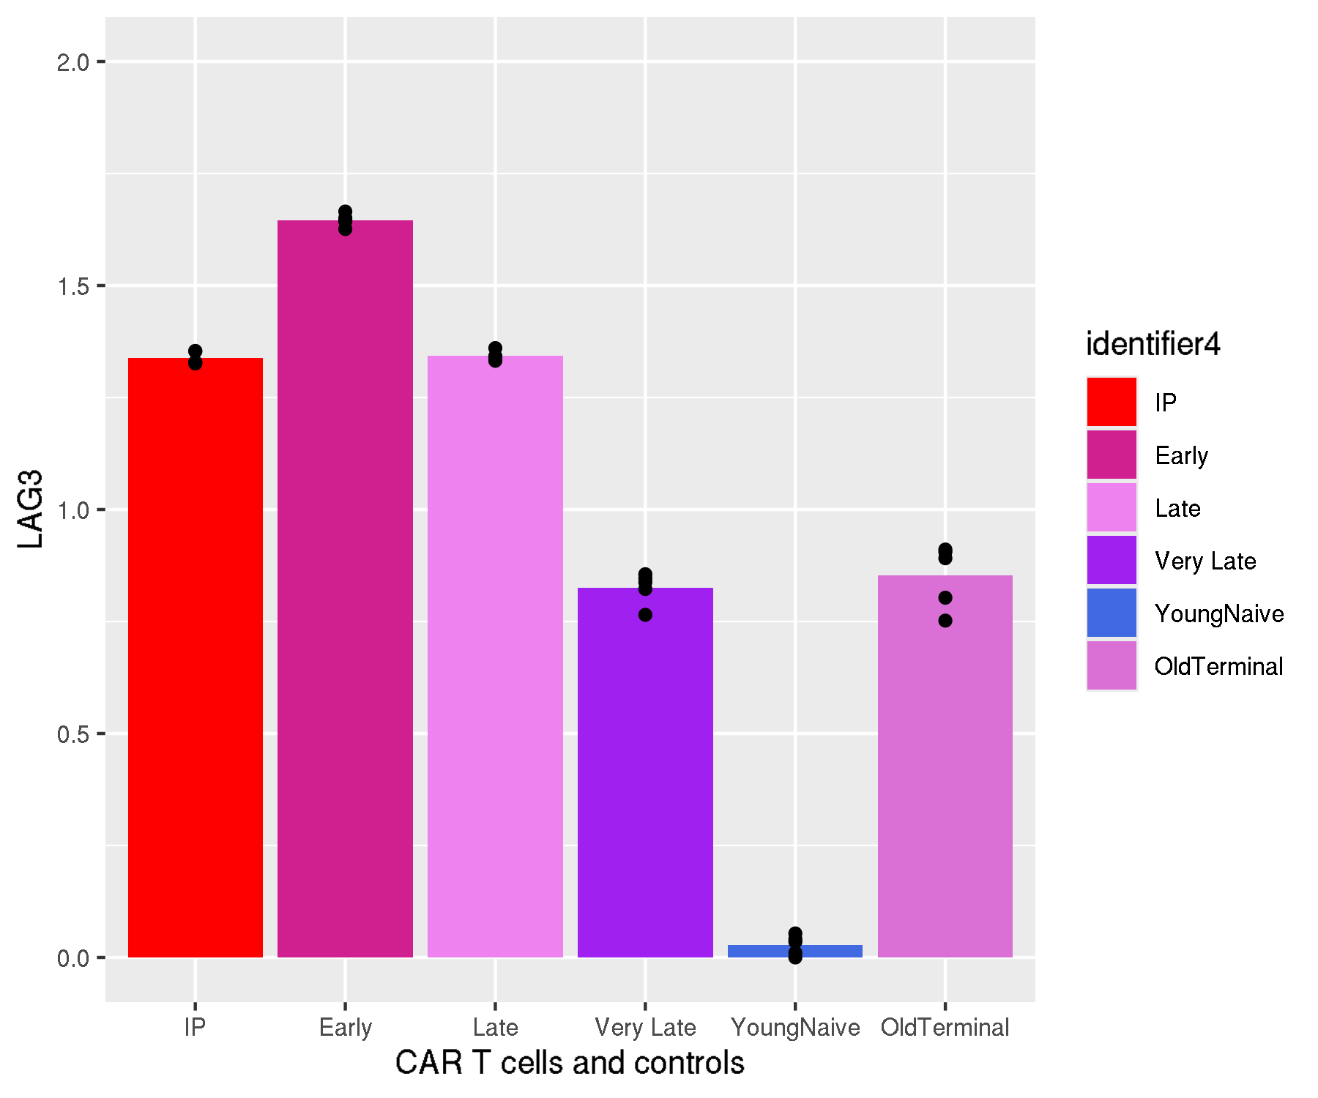
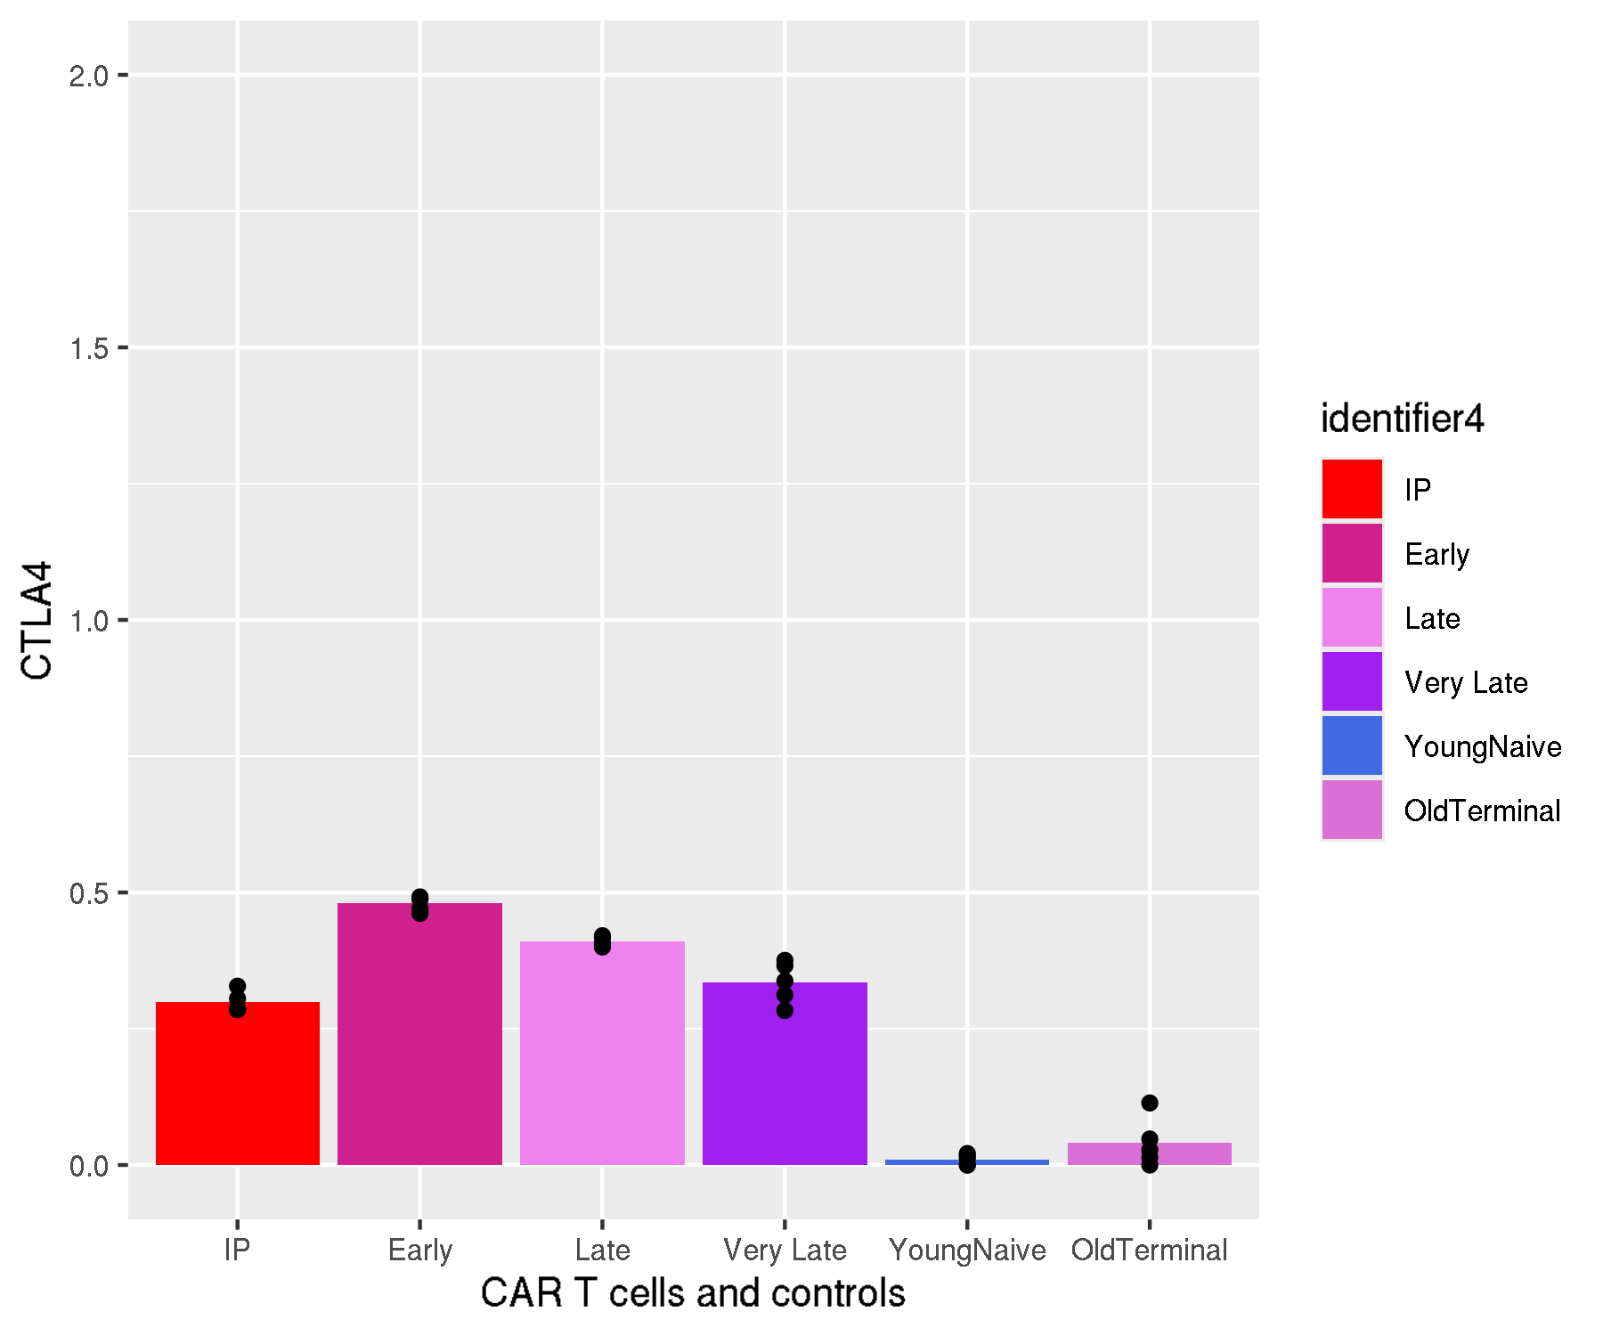
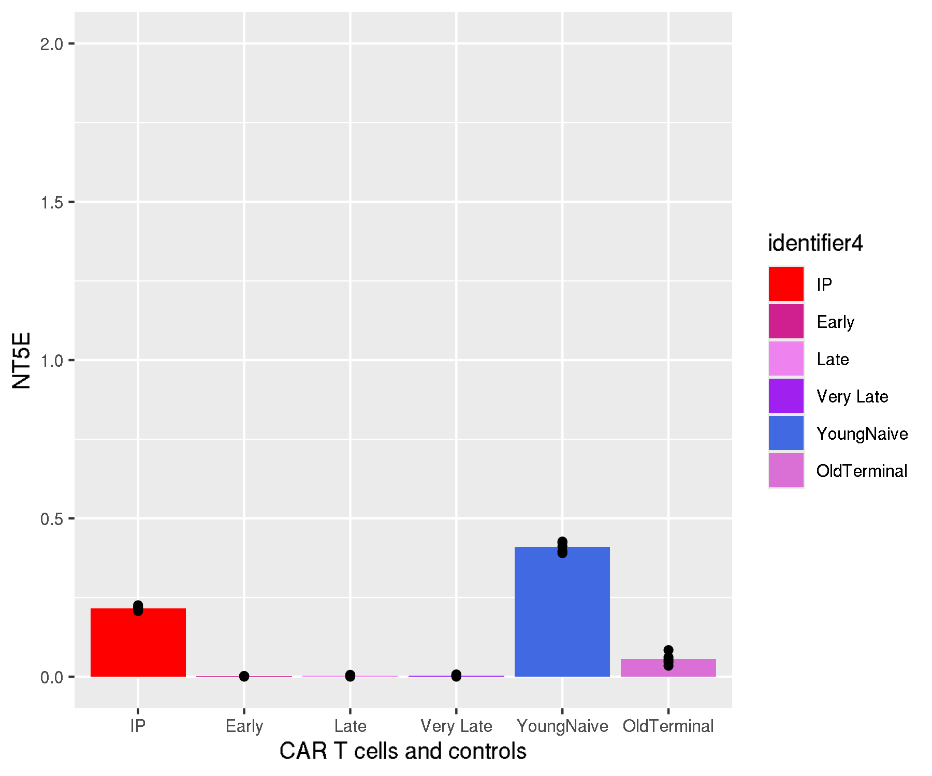
GSE125881: longitudinal kinetics of CD19 CAR T cells in cancer patients
Pseudo-bulk immune checkpoint expression levels

Slide 7
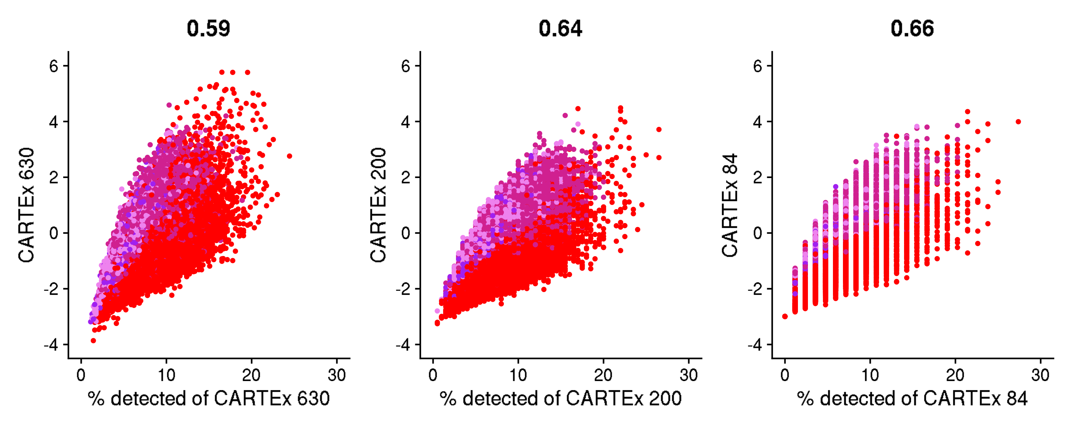
GSE125881: longitudinal kinetics of CD19 CAR T cells in cancer patients
Percentage of CARTEx detected

Slide 8
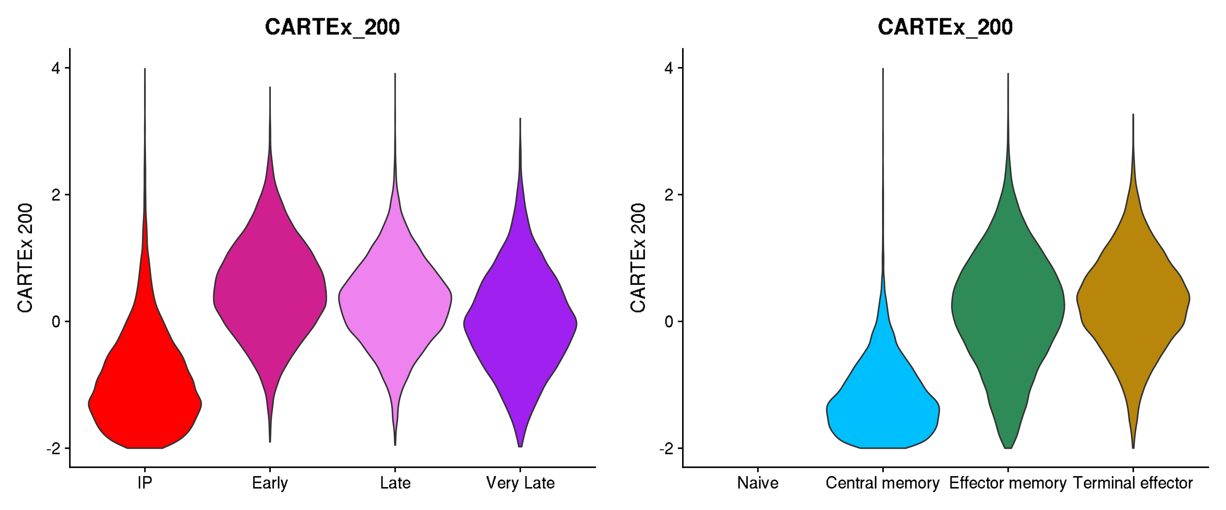
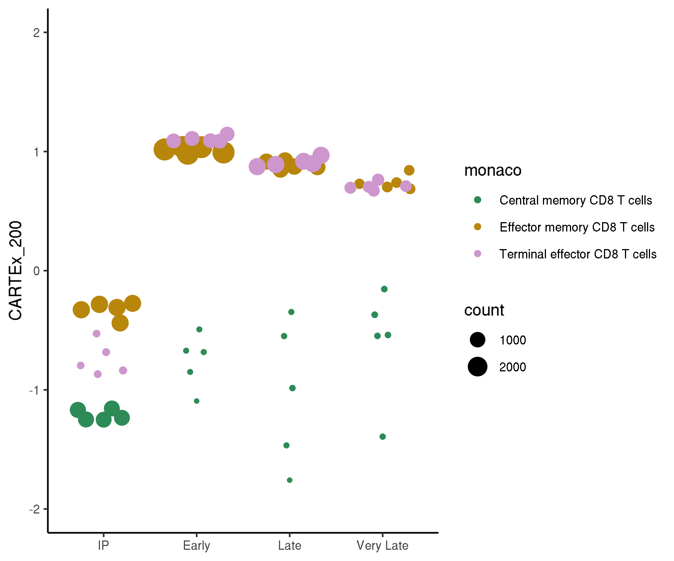
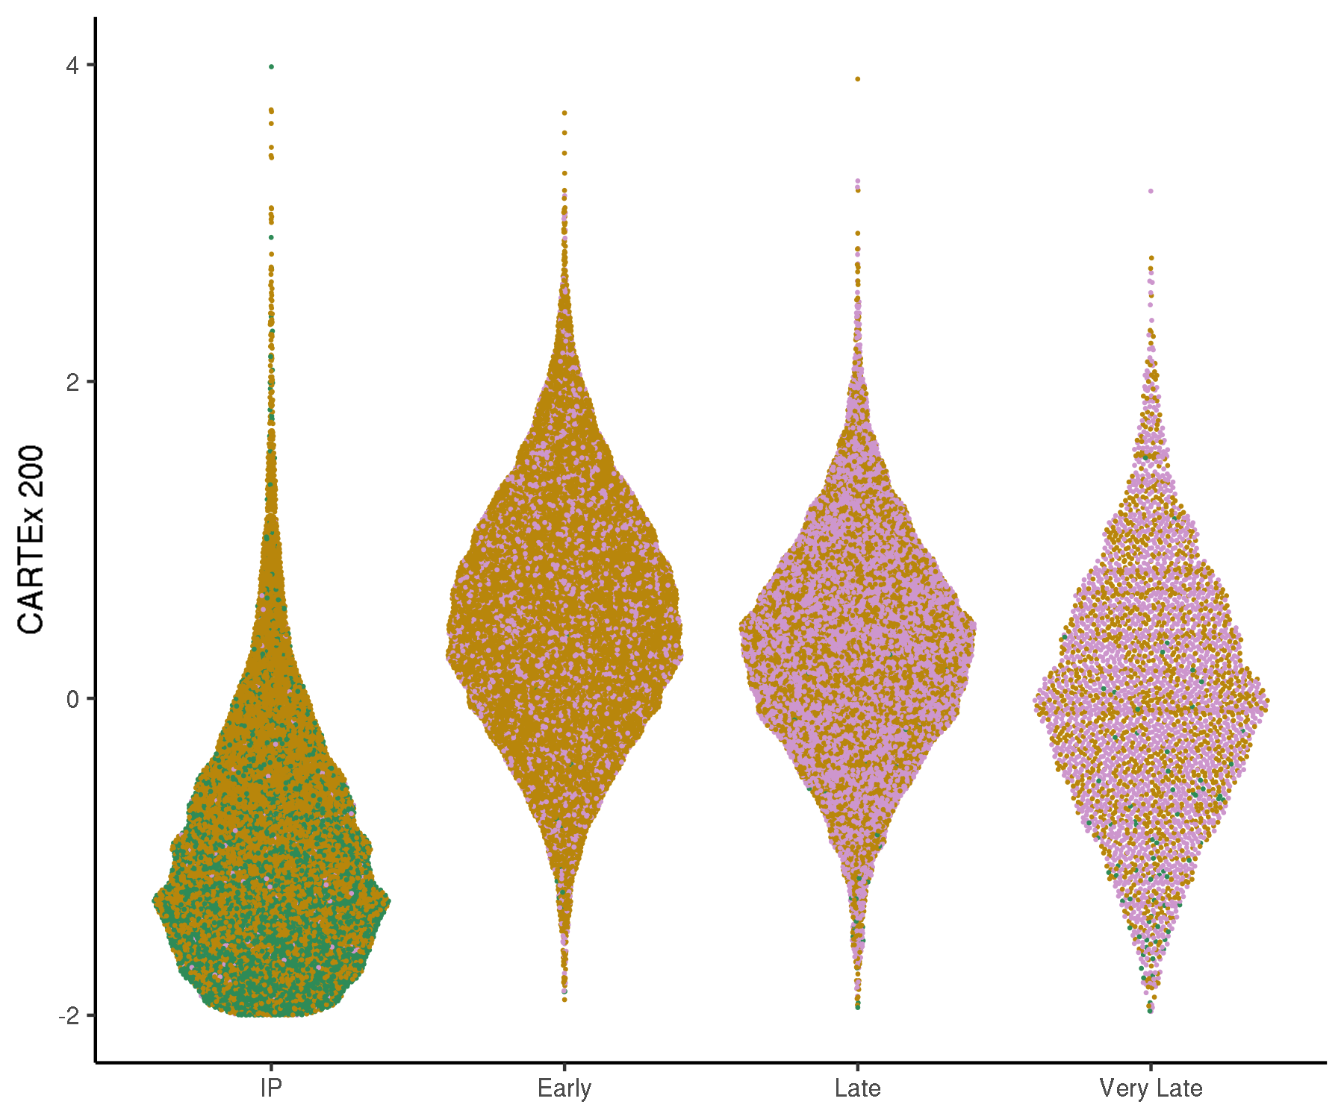
GSE125881: longitudinal kinetics of CD19 CAR T cells in cancer patients
Cell type differentiation

Slide 9
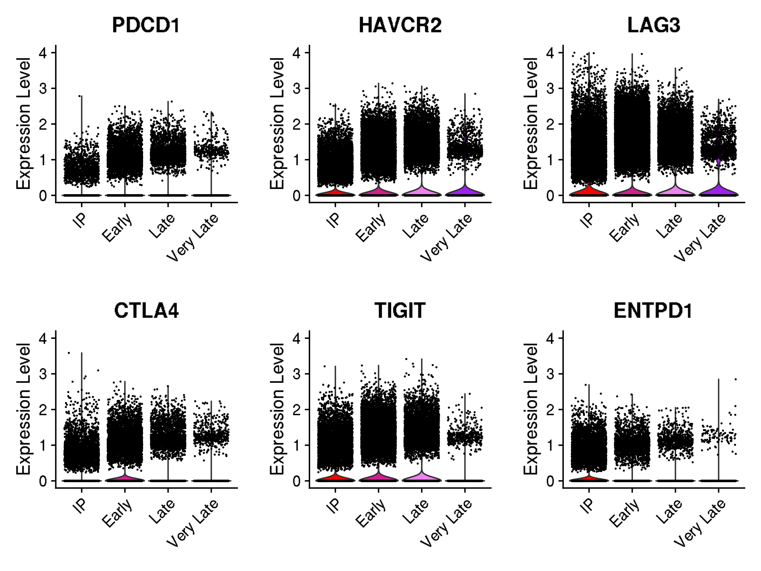
GSE125881: longitudinal kinetics of CD19 CAR T cells in cancer patients
Violin plots for canonical exhaustion markers
Gene and corresponding protein
PDCD1 encodes PD-1
HAVCR2 encodes TIM-3
LAG3 encodes LAG-3
CTLA4 encodes CTLA-4
TIGIT encodes TIGIT
ENTPD1 encodes CD39

Slide 10
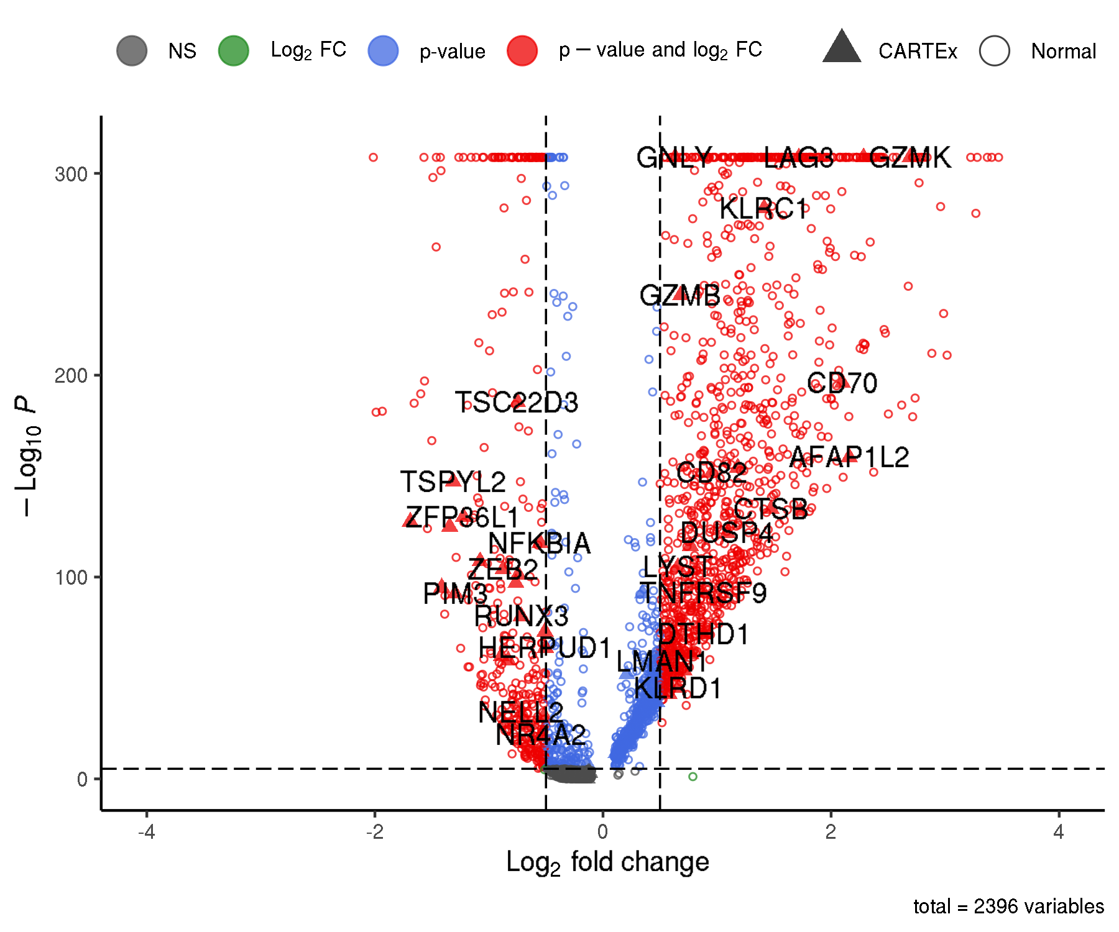
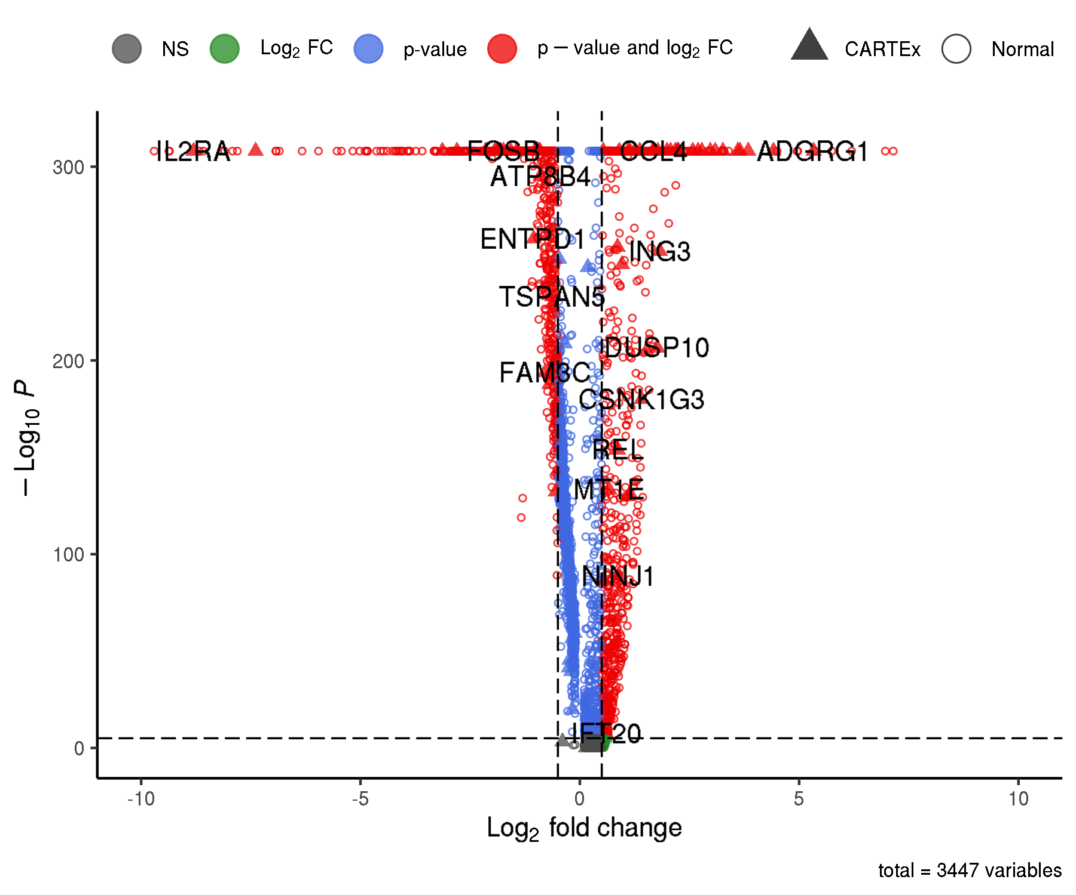
GSE125881: longitudinal kinetics of CD19 CAR T cells in cancer patients
Differentially expressed genes

